Slide 1

European Union / South Sudan
Cooperation
Project: Small Holders Food Security and Livelihoods Project, 2014 -2017
Implemented in Wau and Lol States. ( Former Western Beher El Ghazal)
Implementing agency: Hope Agency for Relief and Development (HARD).
8th Quarterly review meeting held in Juba at EU Compound.
21st to 22rd March 2018
Presented by Dominic Albino M&E Officer

Slide 2
Specific Objective: Increased agricultural production and income of smallholder farmers in Western Bahr el Ghazal state
Results.
R1 - Increased area of land cultivated using animal traction without corresponding decrease in crop yields.
R2 - Increased promotion and adoption of appropriate agricultural practices for 1500 smallholder farmers.
R3 - Increased diversification of crops grown through integrated fruit trees, vegetables and cassava farming.
R4 - Improved post harvest handling and management & increased adoption of post harvest storage facilities and marketing of surplus farm produce.

Slide 3
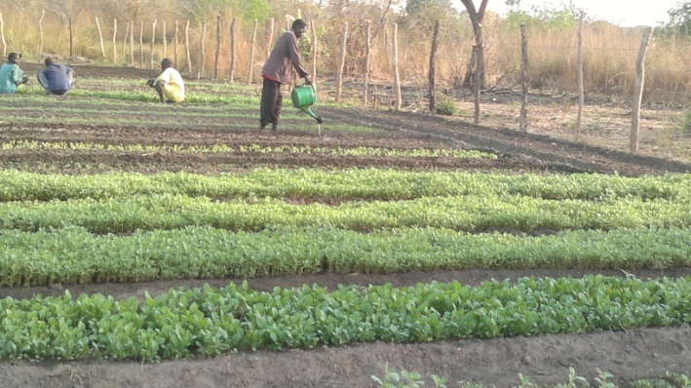
CASE STUDY: KONY PAJO VEGETABLE GROUP, An IDEA BORN OUT OF FARMERS’ FIELD DAY IN THE NEIGBOURING LOCATION
Location
Village: Akolo
Payam: Atido
County: Udicci

Slide 4
INTRODUCTION
Formerly this location was not covered by EU funds interventions. However, members attended farmers field days in Mayen Ameth where they borrowed the idea of social capital to form a SHG
As a result they were motivated to form a group (Kony pacho vegetable group) which today consist of 32 members (M=5, F=27)
One group member (Asunta Aduong) approached HARD for support and were given starter kit then trained by the staffs on vegetable gardening
Mobilization for resources required was then done after visiting a proposed site (1 feddan) which one member donated for the set up of the group garden
This is therefore a classical example on how technologies can out scale spread to neighboring locations once benefits are realized elsewhere.

Slide 5
SITUATION BEFORE
Negative coping mechanisms were rampant
Theft of food/HH items
Charcoal burning
Sale of wood for income
Some of those undermined environmental sustainability & social cohesion
Current Situation after getting training & support in January 2018
Acquired starter kits from HARD and fenced off 1 feddan of land
Excavated 2 shallow wells
Planted vegetables (riggilla, ghirghir, tomato, kales)
Formed VSLA and have 5000 SSP saved within one month
Income generated from sales of vegetable total to 49365 SSP
Records (book) well kept by the group and available for reference
Neighbours buy vegetables locally for home consumption
Surplus sold in the local and Wau suk jow market

Slide 6
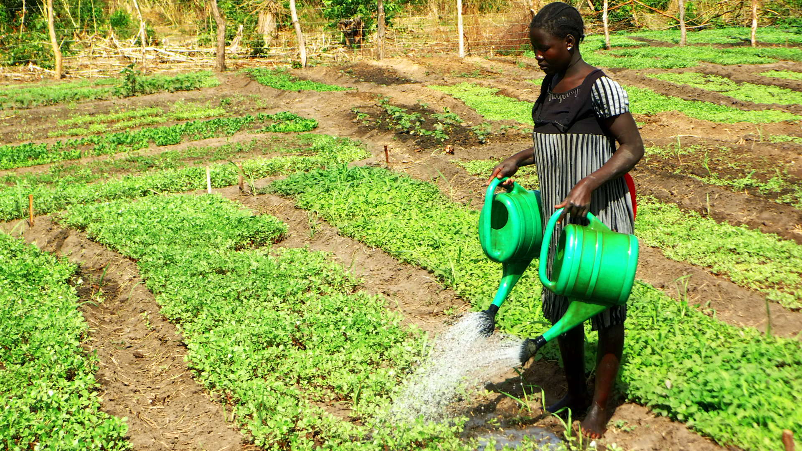
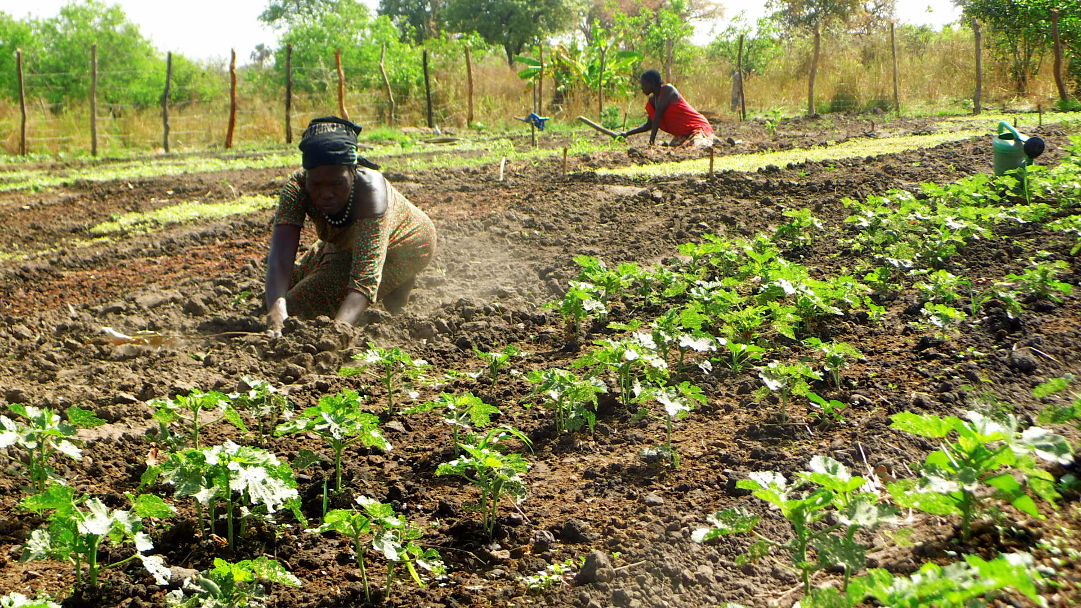
Photos Depicting CURRENT ACTIVITIES GOING ON IN The GARDEN
ROUTINE WATERING OF VEGETABLES BY GROUP MEMBER
GROUP MEMBER PREPARING HER PORTION IN THE GARDEN

Slide 7
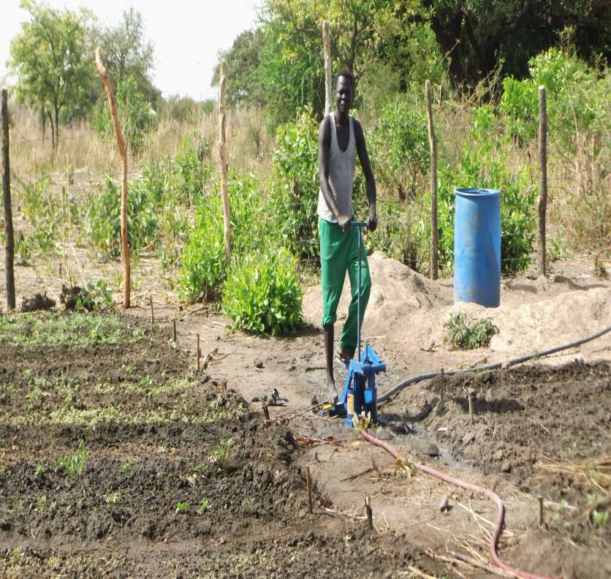
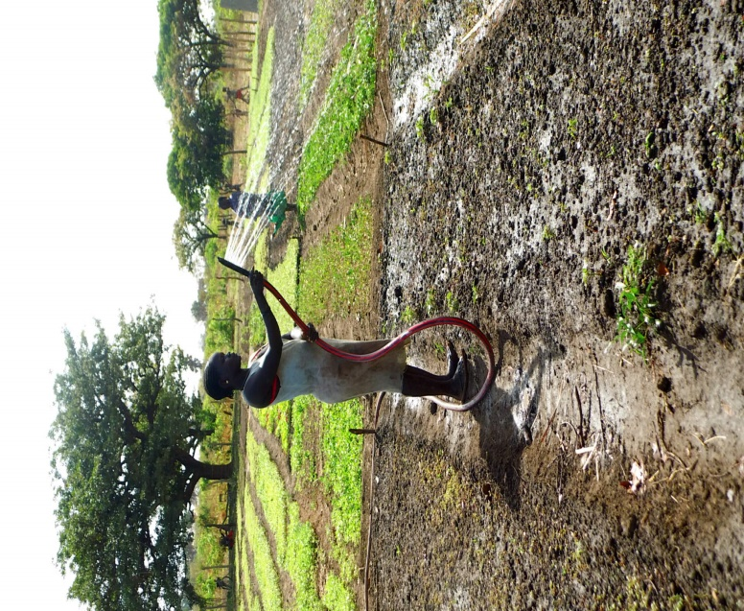
PhotoS CoNTD….
SIMPLE IRRIGATION /PUMPING MECHANISM APPLIED BY THE GROUP TO LIFT WATER FROM SHALLOW WELL AND IRRIGATE VEGETABLES

Slide 8
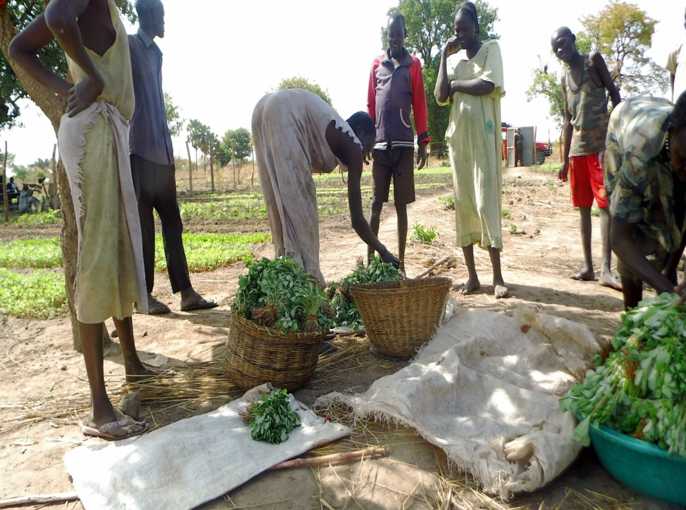
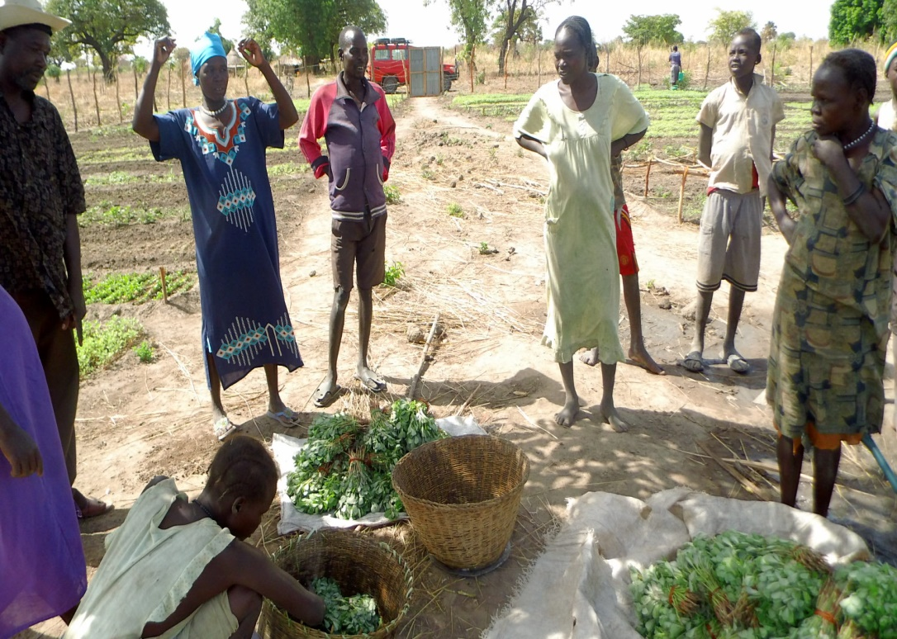
PhOTOS CONTD…
SELECTION AND PACKAGING OF HARVESTED RIGGILLA FOR MARKET (1 Bundle = 20 SSP)

Slide 9
BENEFITS RECITED BY THE GROUP
Households’ incomes and asset building for members (HHs & community resiliency) has been enhanced
There is preservation / conservation of trees which is likely to restore environment in future (environmental sustainability)
Members meeting to do farm work together and contribution during VSLA meetings is a social capital that is building institutional sustainability through social cohesion
Income used to buy other food items, medicine and scholastic materials

Slide 10
KEY LESSONS LEARNT
Limited options of livelihoods have the potential of increasing dependency as it makes households less resilience
Group members understood F2F learning approach in the neighborhood and got motivated. Knowing that their group work contribute to their own wellbeing and other community members in terms of environmental resilience, food security is an important foundation in their context
Opportunities such as trade fairs, famers’ field days and on-farm trainings are key avenues for promoting farmer to farmer information sharing within the community. This has led to out scaling of appropriate technologies to locations initially not covered by the EU funded interventions. This is a strong pointer that farmers in a given set up have unique way through which message flow (even spill over) to increase adoption of technology

Slide 11
CHALLENGES NOTED
The reorganization in the administrative boundaries as a result of new counties or states created has resulted to restructuring of some of the key government departments at the county government level. The use of different names (old & new) used by county and national governments has created some confusion in the community over demarcation of the administrative boundaries for instance payam, boma and county
THANK YOU

