Slide 1
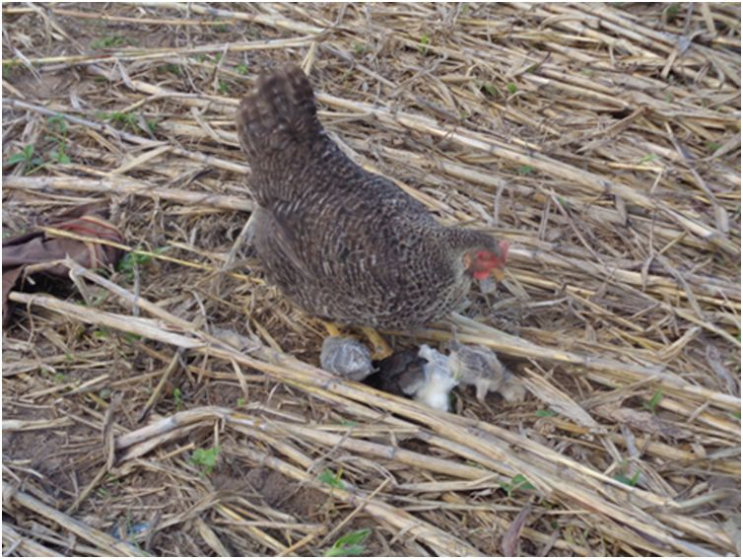

Slide 2





European Union / South Sudan
Cooperation
EU Pro-Resilience Action (PRO-ACT)
Food Security Thematic Programme Crisis Prevention and Post-Crisis Response Strategy Projects
Greater Upper Nile (GUN) and Greater Bahr el Ghazal (GBEG)
INTER-REGIONAL THEMATIC WORKSHOP
Funded by the European Union
Government of South Sudan

Slide 3

Name of Presenter, Daniel Nondi (Project Manager)
Agency:VSF Germany
Contract Reference:DCI-FOOD-2014-337-937
Project: Food security Enhancing Through sustainable Agricultural Production (FESAP)
Juba, 24 - 25 May 2016
Greater Upper Nile (GUN) and Greater Bahr el Ghazal (GBEG)
Inter-regional Thematic Workshop
EU Pro-Resilience Action (PRO-ACT)
Outline
-project background
-
-
-
-
-
-
WORKSHOP THEME
Transitioning from emergency response to resilience building: is it working ?
Two-day information sharing and learning and coordination workshop to Reflect on the strategies and progress of EU funded projects.

Slide 4

Project Background
Title: Food Security Enhancing Through Sustainable Agricultural Production
Duration :36 months
Locations: Gogrial West County (Kuac South and North payams); Gogrial East County: - (Toch North, Pathuon West and Nyang Payams) Warrap State of South Sudan
Project Budget: €1,666,666
Objectives: To contribute to increased food security, reduced vulnerability and enhanced livelihoods of rural communities by supporting household subsistence farmers in Warrap State of South Sudan.
Specific Objectives
Increased agriculture production and productivity through strengthened extension services and innovative farming.
Animal traction is adopted as a viable, cost-effective and sustainable technology and contributes to annual increase in cultivated farmed land, improved tillage and increased productivity per acreage
Increase in household income as a result of access to microfinance, local markets, and linkages to value chain actors
Increased resilience to shocks in climatic/ environmental changes and manmade disasters such as conflict
Purpose
  • Aim:
  Inform GBEG region project managers on emerging innovative programmatic trends in the GUN region,
  Sensitize PRO-ACT projects in the GUN region on resilience measures underway with EU funded projects in the GBEG region.
  • Theme:
  Transitioning from emergency response to resilience building: is it working?
  • Frame:
  Highlight successful innovations and challenges to the realization of the EU funded projects and regional programme short to medium term results.

Slide 5
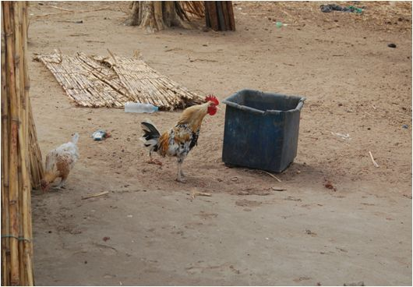
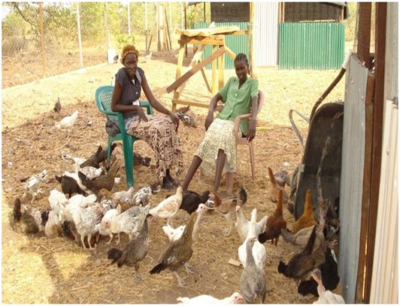
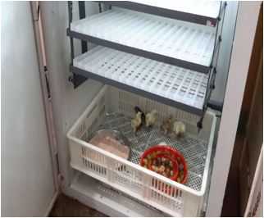
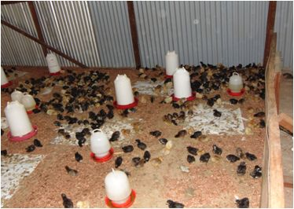
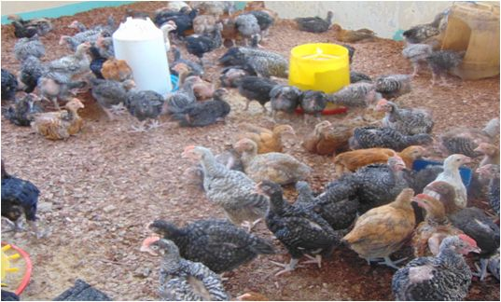
Indigenous breed
The local breed cocks weighed 0.9 kg and hens 0.71kg at the end of 6 months. Their eggs weighed 35g while the chicks weighed 30g.
  Poultry Breeding
  200 indigenous chicken were raised for 6 months under ideal conditions for experimentation
  1,200 one day old improved breed chicks raised for 3 months and distributed to 297 HH for cross breeding purpose to improve the local breed.
  The improved breeds were subjected to free range system with controlled supplies (food and water) to improve their adaptability instincts
The growth rate of the chicks was at 0.02 kg live weight per week under special conditions in the 1st 2 weeks.
Improved breed
+
The chicks weigh 60 g and grew at rate 200g per week at live weight.
The improved eggs were incubated for 21 days to hatch in Luonyaker. Other were outsources from re-known breeder.
Their food intake was at 0.8kg per week per chick in the first 2 weeks and the consumption rate increased as they growth.

Slide 6
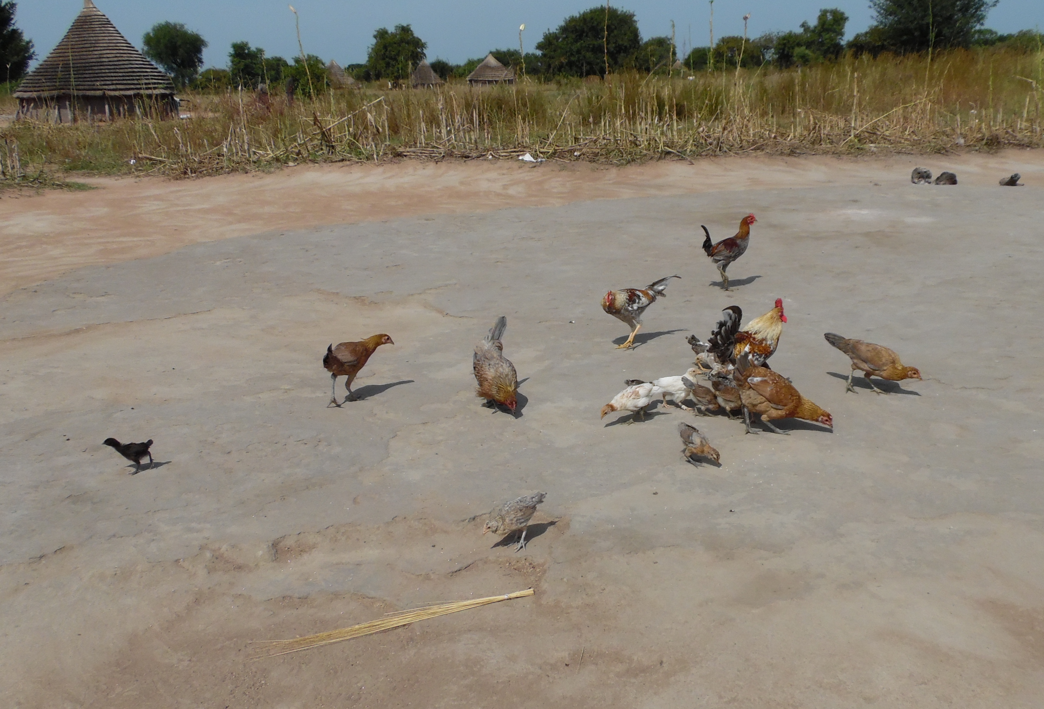
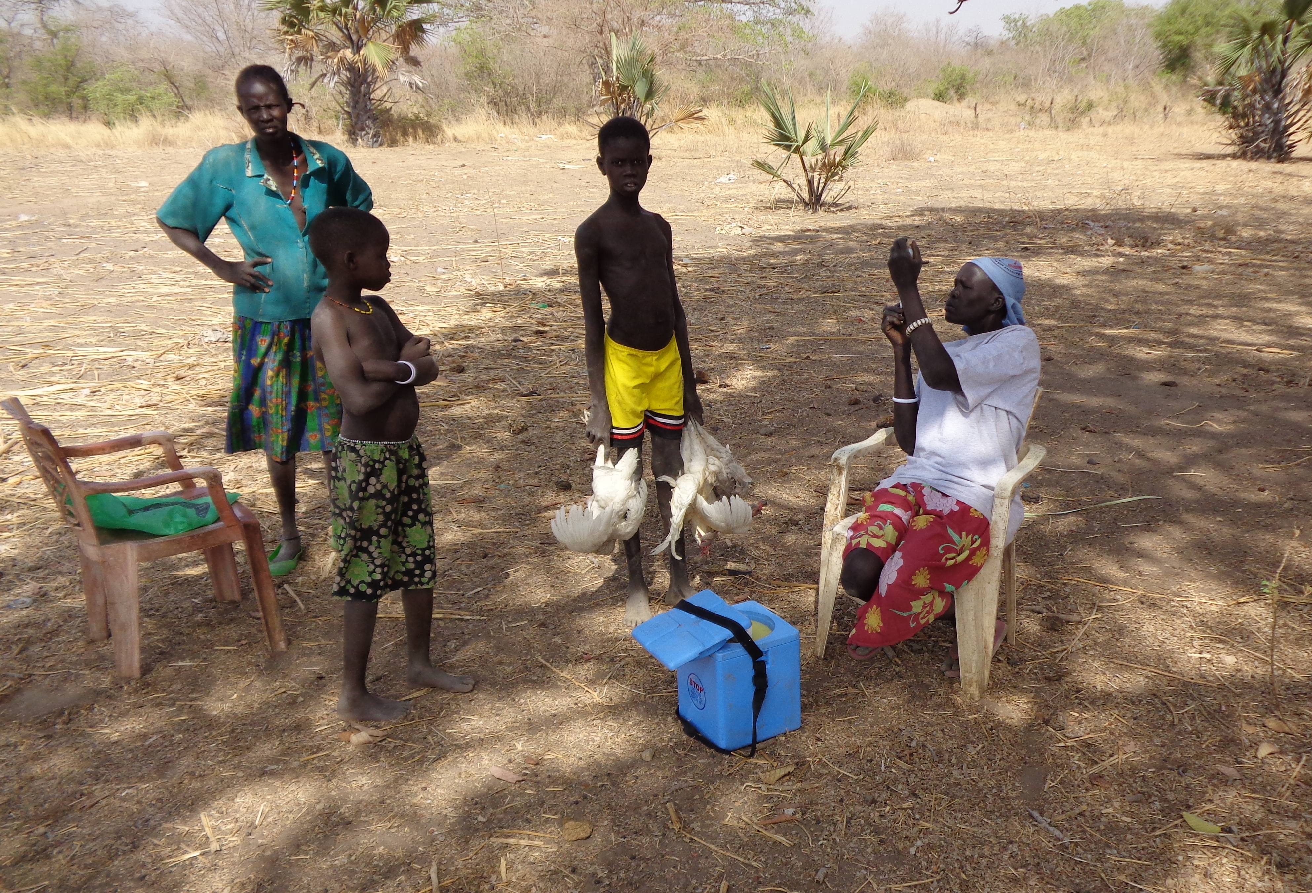
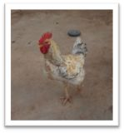
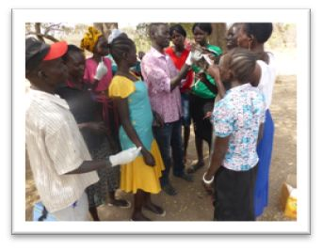
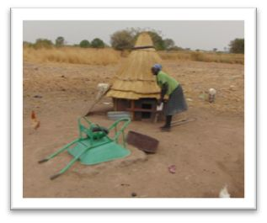
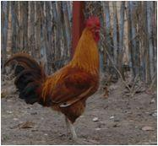
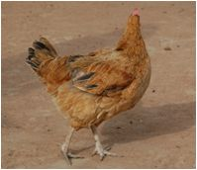
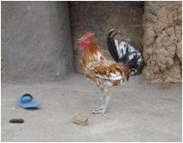
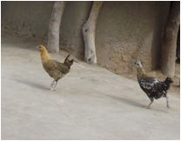
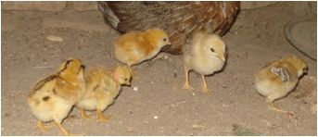
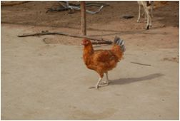
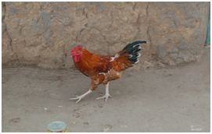
-
Inputs and Output
Training
Treatment and vaccination
Extension
Shelter
Feeds and water
Market and information
feeding
Treatment
-
 | Local breeds | Cross breed
1 | Egg weight- 30g | Egg weight-45g
2 | Chick weight at hatching-35g | Chick weight at hatching-50g
3 | Growth rate per week-0.02kg/wk | Growth rate per week-0.09kg
4 | Hardy | Hardy
5 | Good maternal instincts | Good maternal instincts
7 | Cock weight-0.9kg, hen weight-0.7kg | Cock weight-2kg, hen weight-1.5kg
Trainings
Housing
Improved breeds
Local Breeds
Cross breed-improved

Slide 7
Impact Assessment on chicken production to Warrap Residents (Dec 150)
-
Only 15 % of the interviewed attested to selling chicken for income source.
75% only sold eggs contributing to their HH income.
The average selling price for raw eggs was 1SSP each and for cooked eggs was 2SSP
With an average egg production of 14eggs/HH/week, the weekly projected income ranges from 14-28SSP depending on whether the eggs are sold raw or cooked.
The major income use across the board was for purchase of food with 36% of the respondents attributing to this.
25% used the income for healthcare which especially for malaria treatment. Healthcare also included other minor health ailments as well as overnight emergencies
A further 25% used the income for tuition. The average tuition for one primary school child per term in the assessed Bomas is 15SSP/term. Based on the weekly projected income of 14-28SSP , each HH is able to raise school fees for one child in just one week without having to sell their productive assets.
The remaining 14% have used their income towards savings, of these half of them are saving towards their ASCA contributions (village savings)
The other half is saving towards construction of chicken houses in order to minimize earlier mentioned losses from predators
-

Slide 8
Challenges leading to chicken Losses among the chicken keepers in Warrap state
45 % reported losses attributed to predators especially the wild cats and mongoose
29 % claimed snakes were the main killers of their birds
Flying birds (kites and hawks) was mentioned by 9% of the correspondent as their main problem.
Surprisingly only 9% attributed their losses to disease. This may have been due to proper health care (vaccinations and treatments)
8% claimed losses to theft from interested neighbors.
Less that 2 % mentioned feeding and watering as a problem probably because the chicken were on free range

Slide 9
Key success
2.
-
Increased household income
Improved household nutrition
Improved dignity to women
Increase interest and knowledge in chicken keeping
Key Challenges
Diseases and parasites
Feeds
Logistics (transportation of the chicks)
Predation
Motherbility
Lesson learnt
Chicken has empowered vulnerable households economically in the shortest time ever.
Chicken has contributed enormously to reducing domestic misunderstandings in many HH
-

