Slide 1
Leave no one behind
Rights of persons with disabilities

Slide 2
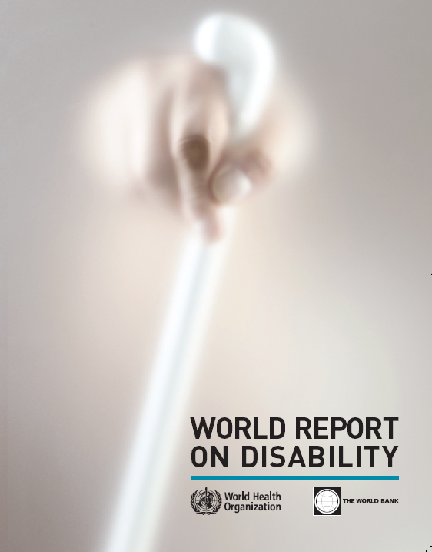
World Disability Report
A key publication – published by the World Health Organisation and the World Bank in 2011. Collected data from developed and developing countries.

Slide 3
Higher estimates of prevalence
1 billion people (15%), of whom 110-190 million adults have very significant difficulties in functioning.
Growing numbers of persons with disabilities
Due partly to ageing populations, increase in chronic diseases, injuries from road traffic crashes, disasters etc..
Inequalities
Disproportionately affects vulnerable populations: women, poorer people, older people.
Not all people with disabilities are equally disadvantaged.
People with disabilities have less access to health care, education, economic opportunities and social life of communities
Families of persons with disabilities are more often poor and have more difficulty to get out of poverty
Notes:
The World Disability Report gives information about people with disabilities as a group. Since the 1970s, WHO has been saying that 10% of the population are disabled. Now, through analysis of the World Health Survey (WHS), the Global Burden of Disease (GBD) Survey, and national surveys, a more accurate estimate is 15% or one billion people.
Secondly, the World report gives information on trends: there are increasing numbers of PWD, because people are living longer (and older people have a higher risk of disability) and because chronic diseases such as arthritis, diabetes and heart diseases are on the rise.
Finally, disability is very diverse and affects people unequally. Poor people, women and older people are more likely to experience disability. And while disability correlates with disadvantage not all people with disabilities are equally disadvantaged. School enrolments differ among impairments. Those most excluded form the labour market are people with intellectual impairments and people with mental health conditions.

Slide 4
Few more facts about persons with disabilities
285 million people across the world are visually impaired, 39 million of which are blind.
90% of people who are visually impaired live in developing countries.
An estimated 38% of people over the age of 60 have an impairment/disability.

Slide 5
Poverty
A study in Tanzania showed that households with a member with a disability have a mean consumption of less than 60% of the average, and include 20% more members than average
Violence
Adults with mental health conditions or children with disabilities are at nearly four times the risk of experiencing violence.

Slide 6
Education
One in three of the 72 million children out of school in 2007 had a disability (the statistic has not been updated for the 61m currently out of school).
In Nepal it is estimated that 85% of all children out-of-school have a disability
Disability has a greater impact on access to education than gender, household economic status or rural/urban divide.

Slide 7
Gender
Studies on women with disabilities in rural areas of many countries in the Asia-Pacific region have found that more than 80% have no independent means of livelihood and are totally dependent on others.
Infrastructure
The cost of integrating accessibility into new buildings and infrastructure can be negligible, amounting to less than 1% of the capital development cost.

Slide 8
Cost of exclusion of persons with disabilities
In low and middle income countries the loss to GDP from the exclusion of people with disabilities from the labour market is estimated by ILO to be between 3 and 7% of GDP.
Conflict and humanitarian
One in five refugees in Jordan and Lebanon is affected by physical, sensory or intellectual impairment; one in seven is affected by chronic disease; one in 20 suffers from injury.

Slide 9
PERSONS
Gender, age, impairments,
Ethnic group…
ENVIRONMENT
Barriers? (to be removed)
Support? (to be provided)
DISABILITY
is a restriction of participation due to interaction between persons with an impairment and barriers and lack of support
Interaction
- Social participation +

Slide 10
The virtous circle of inclusion
States ensure access to support services, consultation of DPOs
States ensure Non discrimination, Accessibility, Awarenes raising
ENVIRONMENT
Persons with disabilities
Community mainstream services, infrastructures, information
Community life
More participation of persons with disabilities in community
More confidence,
more opportunities,
More engagement, more awareness, more accessibility, more support

Slide 11
Diversity of persons with disabilities, support needs and barriers removals
Persons with low vision
Persons with low vision may require training in mobility, access to assistive devices, specific daily living activities related skills, availability of personal assistance at some point,
accessibility of community services, including access to information, and places, including transportation.
Blind persons
Blind persons may require training in mobility, specific daily living activities related skills, access to assistive devices and personal assistance,
accessibility, including information in most accessible formats such as braille, large print, audio, electronic text, of community services and places, including transportation.

Slide 12
Persons that are hard of hearing
Persons who are hard of hearing may require access to hearing aids, assistive devices, and captioning
accessibility of public places and accommodation (hearing loop..)
Deaf persons
Deaf persons need to receive community services in sign language and to be able to express themselves freely in sign language when interacting with e.g. support service personnel who should be proficient in sign language. Deaf persons may benefit from assistive devices in living independently.
Sign language and captioning for TV and cultural services, text books …

Slide 13
Deaf blind persons
Deaf blind persons may require training in mobility, specific daily living activities related skills, access to assistive devices, personal assistance and interpreters
accessibility of community services and places, including transportatio
Person with intellectual disabilities
Persons with intellectual disabilities may require training and counseling in daily living skills, personal assistance or community support network.
It implies also significant awareness and shift of attitudes within community to understand the different abilities and support needs that person with intellectual disabilities might have.
Accessibility with easy to read format

Slide 14
Persons with physical disabilities
Persons with physical disabilities may require assistive devices, adaptation of their home, as well as personal assistance support and counseling for performing their activities of daily living depending of their level of support needs.
It is important to note that while the better accessibility of housing, transport and other community services and facilities will progressively decrease the need for support for many of them, the provision of personal assistance according to person’s choice will always be a key element for those with higher support needs.
Person with psychosocial disabilities
Persons with psychosocial disabilities may choose to access personal assistance, peer support or community support, peer crisis respite, and a wide range of practices. They also include mental health services that are based in community organizing work but that respect obligation of free and informed consent.
It implies also significant awareness and shift of attitudes within community to understand the support needs that person with psychosocial disabilities might have.
Persons with autism, persons with disfigurement, persons with… elderly people who do not consider themselves disabled but might have significant functional difficulties and restriction of participation…

Slide 15
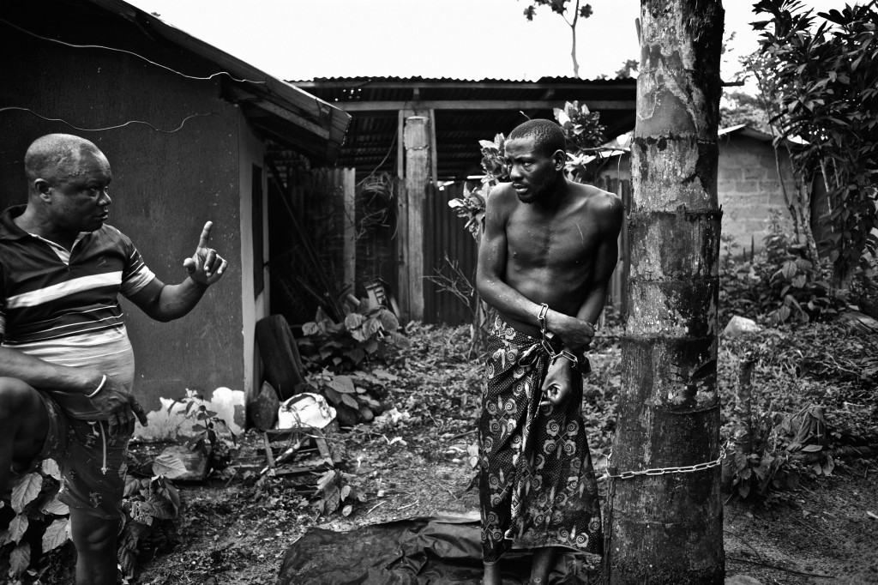
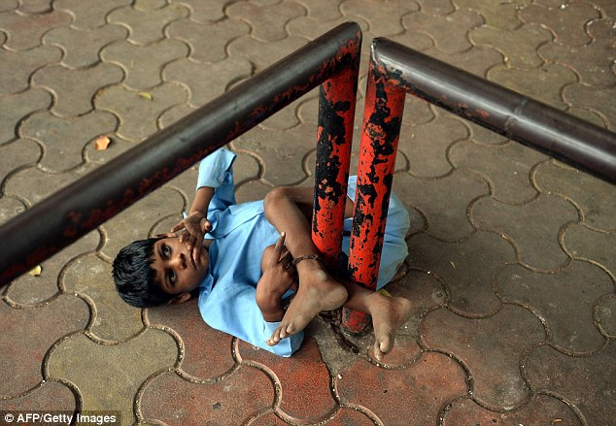

Slide 16
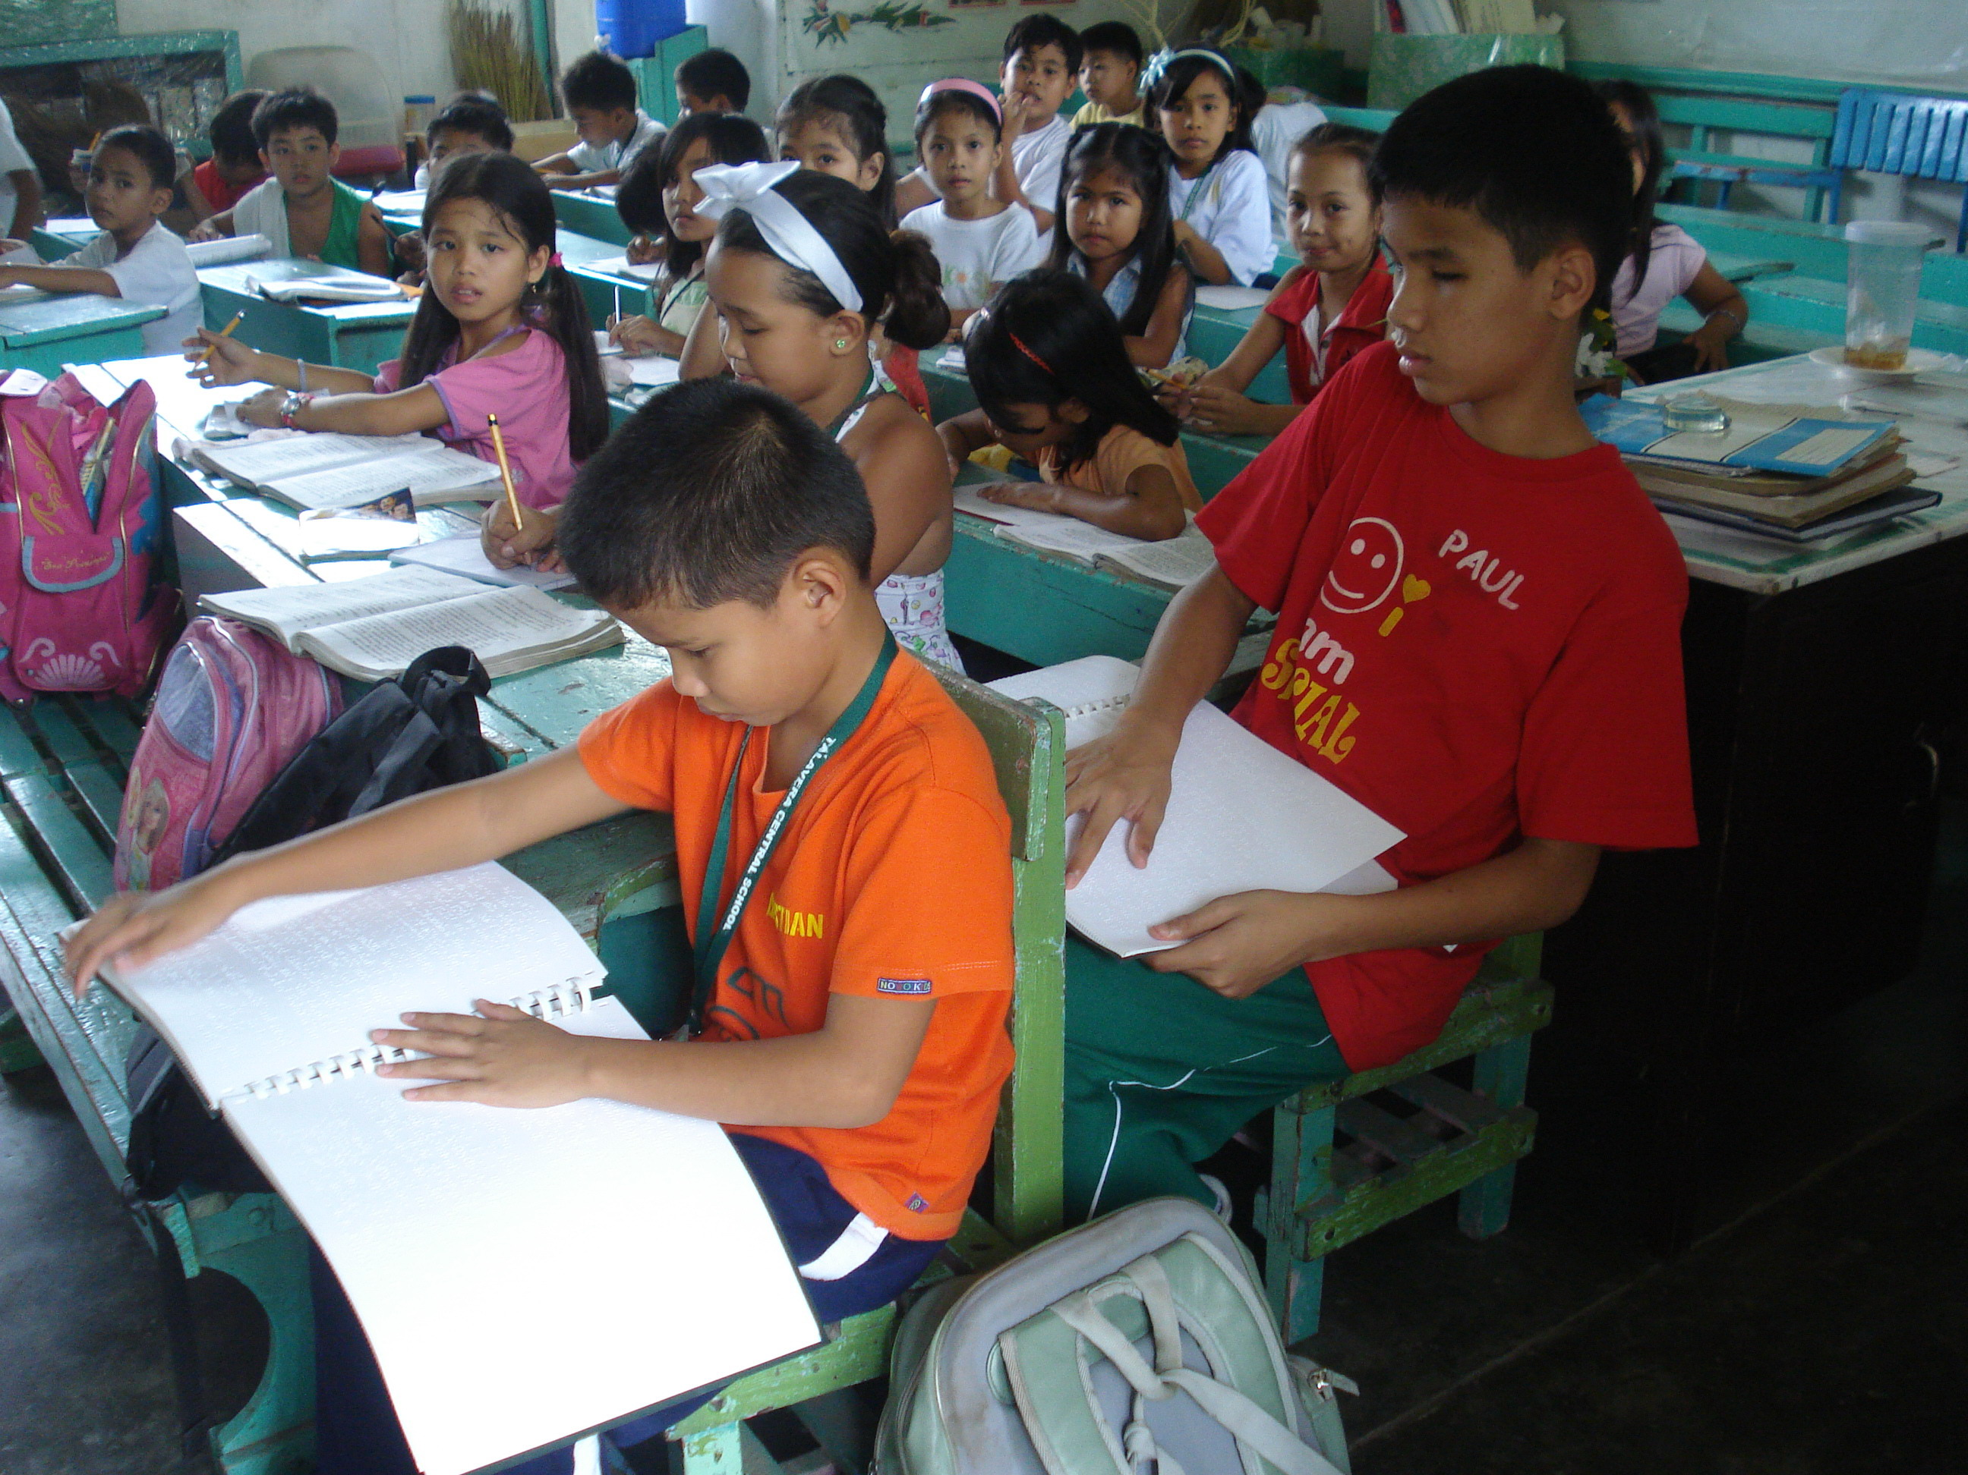
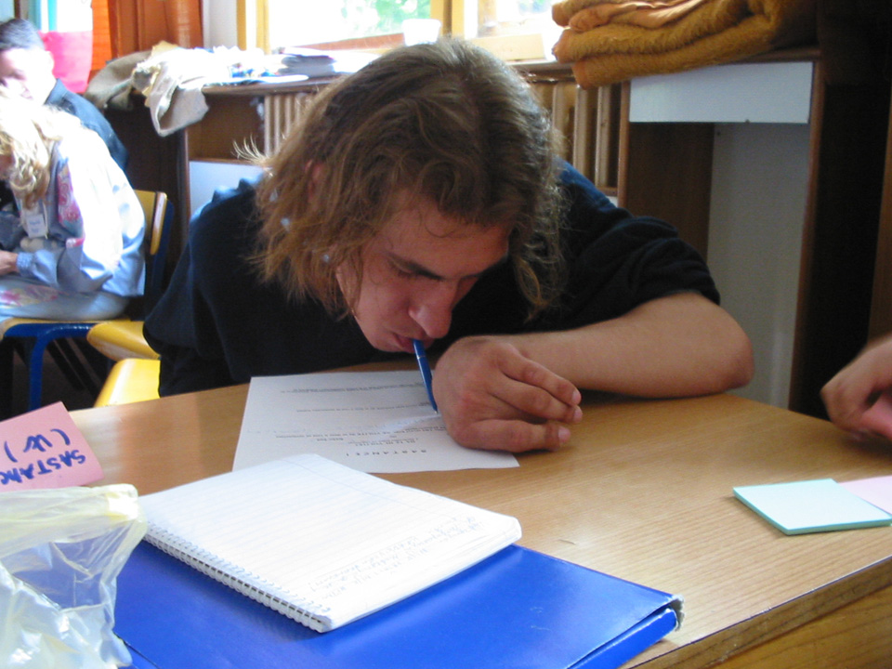

Slide 17
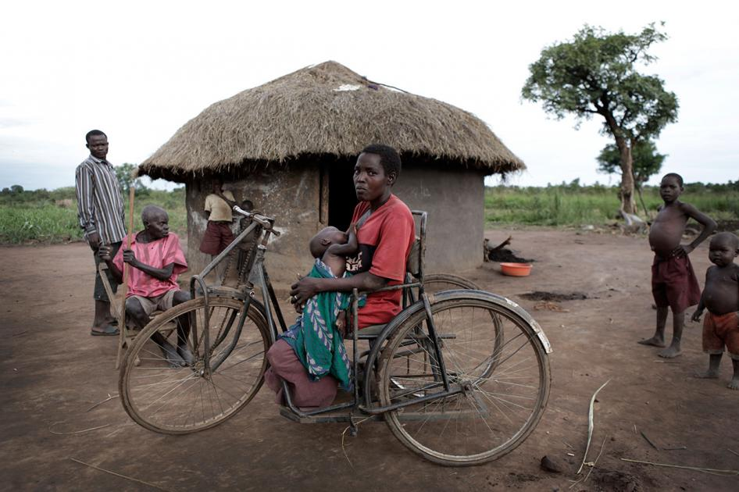
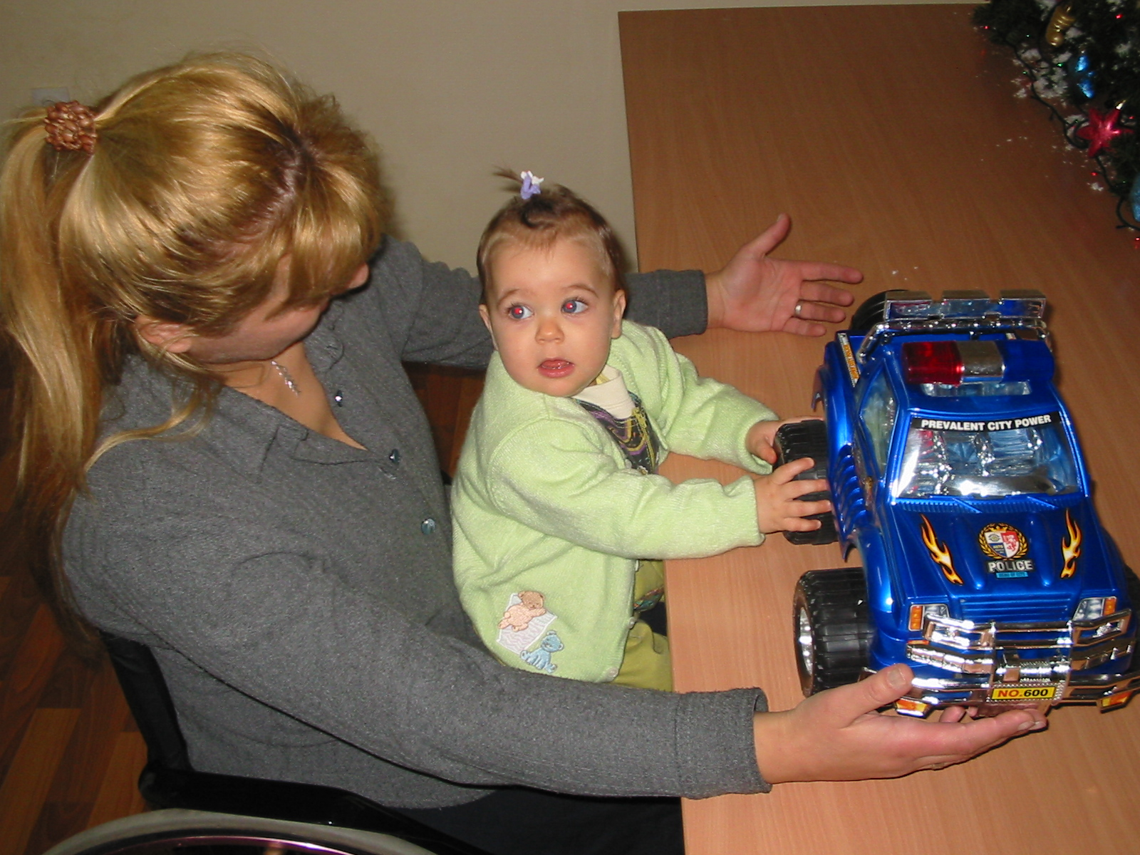

Slide 18
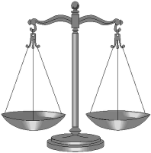
Human rights approach
We, persons with and without disabilities, are part of the same society and we have the same rights and obligations
State
Equal participation
Non- discrimination
Convention Now!

Slide 19
the convention on the rights of persons with disabilities

Slide 20
Purpose of Convention (Article 1)
To promote, protect and ensure the full and equal enjoyment of ALL human rights and fundamental freedoms by ALL persons with disabilities, and to promote respect for their inherent dignity

Slide 21
Convention facts
Adoption by the United Nations General Assembly - 13 December 2006
Opened for signature - 30 March 2007
Entry into force – 3 May 2008
CRPD:161 states ratified, 160 signed
7 conferences of states parties
12 sessions of the Committee on the Rights of Persons with Disabilities more than 35 countries reviewed so far and 2 general comments issued (art 12 and art 9)

Slide 22
A Paradigm Shift
The Convention marks a ‘paradigm shift’ in attitudes and approaches to persons with disabilities.
Persons with disabilities are facing barriers and rights violations that restrict their participation and inclusion
States have the duty to take all adequate measures to remove barriers, tackle discrimination and support persons with disabilities so that they can enjoy all their rights on equal basis with others.
It leaves behind the perspective that response to marginalization of persons with disabilities is solely welfare or medical treatment and medical rehabilitation which historically contributed to consolidating marginalization.

Slide 23
Convention Structure
Preamble
1. Purpose
2. Definitions
3. General principles
4. General obligations
5. Equality and non-discrimination
6. Women with disabilities
7. Children with disabilities
8. Awareness-raising
9. Accessibility
10. Right to life
11. Situations of risk and humanitarian emergencies
12. Equal recognition before the law
13. Access to justice
14. Liberty and security of the person
15. Freedom from torture or cruel, inhuman or degrading treatment or punishment
16. Freedom from exploitation, violence and abuse
17. Protecting the integrity of the person
18. Liberty of movement and nationality

Slide 24
Convention Structure
19. Living independently and being included in the community
20. Personal mobility
21. Freedom of expression and opinion, and access to information
22. Respect for privacy
23. Respect for home and the family
24. Education
25. Health
26. Habilitation and rehabilitation
27. Work and employment
28. Adequate standard of living and social protection
29. Participation in political and public life
30. Participation in cultural life, recreation, leisure and sport
31. Statistics and data collection
32. International cooperation
33. National implementation and monitoring
34 to 40. International monitoring mechanism
41 to 50. Final clauses
Optional protocol

Slide 25
General Principles (Article 3)
- Respect for inherent dignity, individual autonomy including the freedom to make one’s own choices
- Non-discrimination
- Full and effective participation and inclusion in society
- Respect for difference and acceptance of persons with disabilities as part of human diversity and humanity
- Equality of opportunity
- Accessibility
- Equality between men and women
- Respect for the evolving capacities of children with disabilities and respect for the right of children with disabilities to preserve their identities

Slide 26
General obligations (art 4)
States must, among others:
- Take all adequate measures to implement the CRPD
- Make sure that their legal and administrative frameworks as well as all public entities do not discriminate persons with disabilities
- Protect persons with disabilities from discrimination by non-state actors
- Provide information to persons with disabilities on possible support
- Ensure enforcement across decentralisation levels
- Consult persons with disabilities and their representative organisations on all matters related to CRPD implementation

Slide 27
Participation and Inclusion
Full and effective participation and inclusion in society is recognized in the Convention as:
A general principle (article 3)
A general obligation (article 4)
A right (articles 19, 29 and 30)
Participation is important so that persons with disabilities can contribute to decision impacting them and their communities
Full and effective because too often, efforts are made on very specific issues such as rehabilitation and health and leave all the rest and many persons with disabilities out
Notes:
Participation and inclusion are included under the general principles (article 3)
Participation and inclusion are also included under several provisions:
The right to take part in the conduct of public affairs (article 29)
The right to take part in cultural life (article 30)
Inclusion is referred to in several articles eg right to education (article 24), right to live in the community (article 19), habilitation and rehabilitation (article 26).
3) Participation and inclusion are crucial elements in adopting rights-based approaches to development. Participation and inclusion are not only ends in themselves, they are important to the process of decision-making as it concerns development or any other planning. Through participation and inclusion:
The needs and concerns of persons with disabilities become clearer
Persons with disabilities have the opportunity to raise issues and hold decision-makers accountable
Through inclusion, persons with disabilities become more visible and persons without disabilities have the opportunity to learn and change from the experience of persons with disabilities – and vice-versa.

Slide 28
Discrimination on the basis of disability
Civil life
Denial of legal capacity
Forced institutionalization
Forced sterilization
Ill treatment as therapy .
Social and cultural life
Segregated education
Forced medical treatment
Exclusion from the community
Inaccessible environments
Negative attitudes
Political life
Denial of the right to vote
Denial of the right to be elected
Denial of the right to hold public office
Economic life
Denial of reasonable accommodation
Denial of property rights
« Sheltered » employment

Slide 29
Equality and Non discrimination
State should protect persons with disabilities from discrimination on the ground of disability
State should protect persons with disabilities from discrimination on any other grounds on equal basis with others
Duty to provide reasonable accommodation
Specific measures for de facto equality

Slide 30
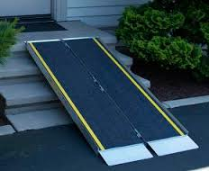
Reasonable accommodation
necessary and appropriate modification and adjustments
not imposing a disproportionate or undue burden,
where needed in a particular case,
to ensure to persons with disabilities the enjoyment or exercise on an equal basis with others of all human rights and fundamental freedoms

Slide 31
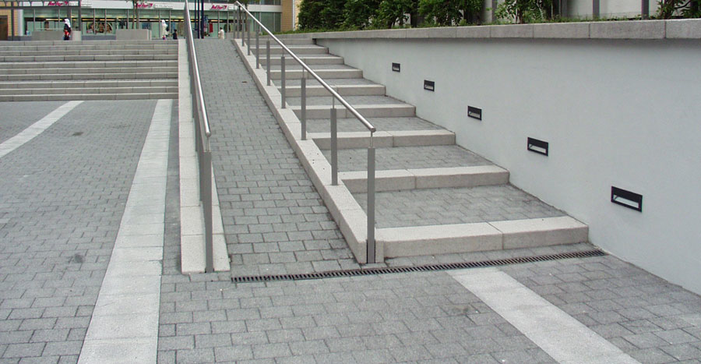
Accessibility
Accessibility is critical to ensure autonomy, inclusion and access to all services, facilities and information.
Both a general principle and a stand-alone article (article 9), it is a core obligation of the state
Government should:
Make sure people with disability have equal access to buildings, roads, transport and public facilities like schools, housing, hospitals, police station and workplaces; and
Make sure people with disability have equal access to information, communications and other services, including electronic services like the Internet and emergency services.
Notes:
Accessibility appears both as a general principle (article 3) as well as a stand-alone article (article 9)
Accessibility is essential to enable persons with disabilities to live independently and participate fully in life – it is therefore an end in itself as well as a means to enjoy other rights.
Accessibility is relevant to a wide range of issues:
Physical accessibility – buildings, transport, etc. – a ramp might make the world of difference – access to schools, access to courts, access to hospitals, access to the workplace are essential to the enjoyment of human rights
Information and communication accessibility – e-accessibility is very important given the importance of the internet to access information, but also accessibility to documentation (Braille) or to aural information (sign language)
4) Thinking of accessibility in the design of buildings, web-sites etc might not incur added cost, yet re-fitting can be expensive.

Slide 32
Accessibility
While it will take time to make all environment accessible, it is critical to ensure that all new buildings and services are thought and made accessible
In absence of accessibility reasonable accommodation should be provided
Some questions:
Are there standards and guidelines for access to facilities and services that are open to the public;
Are there regulations for private businesses that provide facilities or services to the public to take into account access for people with disability?
Are there training for people that have a job that can impact accessibility for people with disability (architect, engineer, broadcast, web designer…)?
Are there system to training and contract professional sign language interpreters?

Slide 33
Fiji constitution
Rights of persons with disabilities
A person with any disability has the right
(a) to reasonable access to all places, public transport and information;
(b) to use sign language, Braille or other appropriate means of communication; and
(c) to reasonable access to necessary materials, substances and devices relating to the person’s disability.
(2) A person with any disability has the right to reasonable adaptation of buildings, infrastructure, vehicles, working arrangements, rules, practices or procedures, to enable their full participation in society and the effective realisation of their rights.
(3) To the extent that it is necessary, a law or an administrative action taken under a law may limit, or may authorise the limitation of, the rights set out in this section.

Slide 34
Article 19: Living independently and being included in the community
To ensure full inclusion state should ensure that people with disabilities have:
Equal choice and freedom to choose where and with who they live
Access to support services that allow them to be autonomous and live by their choice
Access to all services in the community and that those services are responsive to their needs

Slide 35
CRPD pay specific attention to
Art 6: Women with disabilities
Art 7: Children with disabilities
Art 11: Situation of risks and humanitarian crisis

Slide 36
How much is spent for support to persons with disabilities ?
OECD members spend in average 1.2% on disability benefits (2% if long term sickness is included)
South Africa at least 0.5% of GDP in disability cash benefits
India union budget for disability is 0.01% of GPD (which doesn’t include state expenditures)
In Philippines, 0.02% of the GDP-0.1% of the overall budget
In Nepal, 0.02% of GDP on disability benefit
In samoa 0.01%of the GDP

Slide 37
Effective Participation of DPOs
State have to ensure effective participation and involvement of persons with disabilities and their representatives in all decisions, policies and programmes that impact their lives
It must involve them meaningfully
It includes the monitoring of this convention

Slide 38
No-gap Policy
No entity can achieve the goal of equality for persons with disabilities on its own.
A whole of government approach across sectors and decentralisation level is required to ensure implementation of CRPD
Different entities need to ensure that their respective spheres of responsibility provide the necessary access and support to persons with disabilities
If any one element fails, persons are not able to reap the benefit from the other elements.
There are orphans issues that no ministries or UN agencies is specifically in charge of : for instance development of sign language interpretation system

Slide 39
Provisions for implementation
Art 31: governments have to collect data :
to know what to do, where and when
To monitor if things are going better for persons with persons with disabilities
Art 32: International cooperation,
including international development programmes should be inclusive of, and accessible to, persons with disabilities
Art 33: governments have to:
Organise coordination between all the ministries and agencies that have to do something
Make sure that there is an independent body that monitor if government is doing its work

Slide 40
What can you do?
- Ensure and require accessibility across activities and projects.
- Support DPOs to conduct accessibility audit of EU funded project and others.
- Support DPOs to monitor the CRPD and advocate for its implementation
- Support local authorities to implement accessibility plan and support services
- Consult the diversity of DPOs
- Insist to get disaggregated data, support national statistical offices to disaggregate
- Get it right! Not any programs for persons with disabilities is inclusive. Check the CRPD principles.

