Slide 1
Introduction to OPSYS Ecosystem
For External Partners
OPSYS Change Management and User Engagement Team, DG INTPA R5
19.03.2021

Slide 2
Agenda
OPSYS Ecosystem State-of-Play
Access rights in the Funding & Tender Portal
The minimum configuration
Participant Identification Code registration
Change Management Resources
Technical Guides, videos, awareness webinars etc.
1
2
3
4

Slide 3
Speakers
Thierry DUDERMEL
Head of Sector – User Support, DG INTPA R5
Laura Maria GONZALEZ ALBERTI
Senior Trainer and Training Lead, Change Management, DG INTPA R5
Lissa CHAZOT
Awareness & Dissemination Officer, Change Management, DG INTPA R5

Slide 4
OPSYS Ecosystem State-of-Play
The current state-of-play of EU External Actions in a global context and the expected changes in the IT landscape for External Actions

Slide 5
EU external policy: who does what
European Commission
DG INTPA develops EU cooperation policies and designs and delivers EU partnership programmes around the world. Formerly called DG DEVCO.
DG NEAR designs and implements EU neighbourhood & enlargement policy
DG ECHO delivers EU international humanitarian aid and civil protection
DG TRADE manages trade and investment relations with non-EU countries and negotiates and concludes international trade agreements for the EU
FPI (Service for Foreign Policy Instruments) runs a number of EU foreign policy actions and manages operations including their financing
EEAS
The European External Action Service is the EU's foreign and diplomatic service. Under the auspices of the Union's security and foreign affairs High Representative the EEAS conducts EU common foreign and security policy
RELEX
RELEX
RELEX

Slide 6
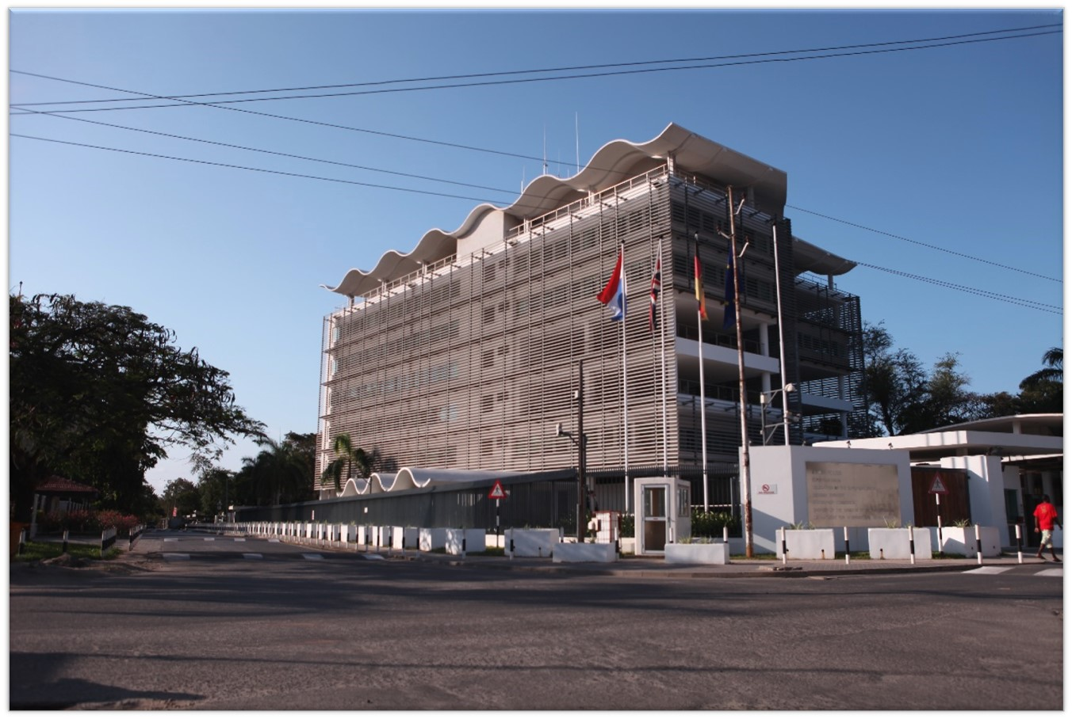
EU Delegations
140 EU Delegations and Offices operating around the world
EU Delegation in Tanzania

Slide 7
The EU is the world’s leading donor
The EU and its Member States are the biggest providers of development cooperation in the world.
In 2018, the EU’s collective ODA was 74.4 billion EUR, which is almost 57% of the world’s total development assistance (ODA).
Source: OECD-DAC preliminary data published on 10 April 2019

Slide 8
New Multiannual Financial Framework 2021-2027 External Actions Heading Amounts
MFF 2021-2027
HEADING VI: Neighbourhood and the world | Amounts (billion euro)
Neighbourhood, Development and International Cooperation Instrument | 79.462
Instrument for Pre-accession assistance | 14.162
Humanitarian aid | 11.569
Common Foreign and Security Policy | 2.679
Overseas countries and territories including Greenland | 0.5
European Instrument for Nuclear Safety | 0.3
Other | 1.542
Margin | 684
Total | 110.597
European Peace Facility | 5.000

Slide 9
NDICI (Neighbourhood, Development and International Cooperation Instrument 2021-2027)
Geographic
Thematic
Rapid Response
Neighbourhood
Sub-Sahara Africa
Asia and Pacific
The Americas and The Caribbean
Human Rights and Democracy
Civil Society Organisations
Stability and Peace
Global Challenges
Crisis Response and Conflict Prevention
Resilience and linking humanitarian and development actions
Foreign policy needs and priorities
Erasmus
Emerging challenges and priorities cushion
Investment
Geographic approach preferred; Thematic programmes + rapid response complementary

Slide 10
NDICI compared to MFF 2014-2020 instruments

Slide 11
Procedures for Procurement and Grant Award
The PRAG
The PRAG is the Practical Guide to procurement and grant award procedures for the European Union External Actions. This document explains the contracting procedures applicable to EU External Actions financed by the EU budget and the European Development Fund (EDF)
DG INTPA, DG NEAR and FPI use the PRAG.
Link to the PRAG

Slide 12
Implementation modes according to the PRAG
Implementation "modality" = type of financing & management mode
The type of financing reflects the legal relationship between the EU and the recipient
Budget support
Grants
Public procurement
Financial instruments
Management mode = the legal arrangement used to channel the funds
Commission contract with the implementing partner (direct) or an intermediary (indirect):
Partner country
Agency of a Member State/EFTA/other donor
International organisation (UN, World Bank,…)
European Investment Bank/Fund
EU specialised agency
Non-governmental organisation

Slide 13
Management Modes according to the PRAG
DIRECT
INDIRECT
SHARED
HEADQUARTERS
EU DELEGATIONS
EU MEMBER STATE
PARTNER COUNTRIES
INT'L ORGANISATIONS
OTHERS

Slide 14
The aid effectiveness process
Ownership
Focus on results
New Information System!
OPSYS Ecosystem
Inclusive Partnerships
Transparency & Mutual accountability
2003
Rome
2008
Accra
2005
Paris
2011
Busan

Slide 15
What is OPSYS Ecosystem?
OPSYS Ecosystem is an Information System striving to bring in large-scale business transformation programme for the RELEX family. The objective is to bring in “more efficient, transparent and results-oriented planning, management, and follow-up of EU external actions”
OPSYS
RELEX family (DG INTPA, DG NEAR, FPI)
Developed by DIGIT, RTD (+ BUDG, JRC)
Coverage: The entire programme-project cycle
OPSYS Ecosystem will interface with:
ABAC (Accrual-based Accounting System)
ARES (Advanced Records System)
EAMR (External Assistance Management Report)
OPSYS Ecosystem will integrate:
CRIS (Common External Relations Information System)
ROM (Results Oriented Monitoring Module)
EVAL (Evaluation Module)
e-Procurement
PROSPECT (application submission)
PADOR (organisation registration)
Audit
Grant Management
GIS

Slide 16
Why OPSYS Ecosystem?
USER CENTRICITY
My workplace, ownership and receipt of notifications about tasks, visual representation of progress
IMPROVED TRANSPARENCY
Access to all applications, No re-encoding, Automatic interface with ABAC and ARES address communication gaps
RESULT FOCUS
Strategic focus on results and performance. Improved decision making & monitoring
IMPROVED
PRODUCTIVITY
Automatic generation of documentation/contracts,
E-signature
Faster problem solving
IMPROVED COLLABORATION with internal and external partners
Maximize IP contribution.
External users gain access to the system (Funding and Tender Opportunities Portal)

Slide 17
Summary
OPSYS Ecosystem is compliant with ‘EU for Results’
OPSYS Ecosystem, a tool for "EU Budget & Policies Performance Monitoring and follow up"
better spending | increased accountability and transparency | maximum added value for EU citizens
Results framework through cycles of operations
Result and performance Indicators (logframe result chain) | Sectors & cross-cutting allocations | Policy markers | Geographical location
Internal “performance management”
Collect and monitor relevant key performance indicators (KPIs)

Slide 18
Locating it
How can External Partners access it?
You can access OPSYS ecosystem via the Funding and Tender Opportunities Portal, the single entry point for external partners.
Partners can use it to search for Calls for Tenders, register the organization, get a PIC etc. For results reporting, external partners can have access after they have been authorized by a European Commission staff member (the operational manager in charge of the intervention).
Know more
Funding and Tender Opportunities Portal
Also called 'The Portal' or 'Funding and Tenders Portal' | Link | Please use Chrome or Firefox
Documentation
EXACT Wiki (Technical Guides + Video Tutorial) | Link
EU International Partnerships Academy (e-Learning) | Link

Slide 19
What is possible in OPSYS Ecosystem today?
Internal users
External users
Result Management: Logframe Management > Logframes and Indicators (currently under review)
Contract Management: Specific Contracts under Framework Contracts SIEA2018, AUDIT2018, PSF2019, EVA2020 and EVENTS2020
Access to OPSYS Ecosystem via the Funding and Tender Opportunities Portal
Register organization and obtain a Participant Identification Code (PIC)
Locate Calls for Tenders after EuropeAid was phased out. Prior Information Notice (PIN) not mandatory.
Result Management: Encode Logframes Data > Logframes and Indicators (currently under review)

Slide 20
Important take-aways
From now on, check the Funding and Tender Opportunities Portal for Calls for Tenders for External Actions
All contracts will eventually be managed in OPSYS Ecosystem
Results Reporting under review, changes are expected
OPSYS Ecosystem is getting ready for the MFF 2021-2027
eCalls Prospect will be phased out, External Actions DGs are expected to adopt eGrants in 2022

Slide 21
How External Partners can collaborate with EC staff today?
for modules available in OPSYS Ecosystem today
Result Management
Contract Management
Under Review
in LOGFRAMES (INTERVENTIONS)
(core tool of the PPCM methodology) – currently under review
NO NEED FOR A PIC!
The EC Operational Manager grants access
to the Lead Implementing Partner (LIP – external partner) via email. Notification is sent to the LIP via the Funding and Tender Opportunities Portal and via email
For Specific Contracts under a Framework Contract e.g SIEA 2018, AUDIT 2018, PSF 2019 (FPI), EVA 2020, EVENTS 2020
PIC NEEDED!
Framework Contractors have registered their profiles in Funding and Tender Opportunities Portal. They have obtained an official PIC and identified a PCoCo.

Slide 22
Does this concern you?
Yes
if you are a Contractor of a Services, Works or Supplies Contract;
If you are a Beneficiary of a Grant Contract;
If you are a Contractor of a Contribution Agreement;
If you are a Framework Contractor;
with INTPA, NEAR or FPI
As an Implementing Partner, you can access your interventions and notifications, as well as update the logframes and results for your projects. You first need to have an active EU Login Account to then login to the Funding & Tender Opportunities Portal after your Operational Manager (EC staff) to the intervention has granted you access. Guidance on managing your interventions is available here.
As a Framework Contractor, you can access your invitations, submit a tender offer, and manage your Specific Contracts via the Funding & Tender Opportunities Portal. There are 5 active Framework Contracts SIEA 2018, AUDIT 2018, PSF 2019, EVA 2020, and EVENTS 2020. Please view the dedicated documentation here.
Under Review

Slide 23
Why should you consider OPSYS Ecosystem?
In the next months, the way to apply for EU External Actions funding opportunities and manage External Actions Contracts will change, the Funding & Tender Opportunities Portal will become the single-entry point for the European Commission.
Applicable to Contractors who have an ongoing Contract and those potential Contractors who do not have yet a ongoing Contract: In this transition, please register your organisation in the Funding and Tender Opportunities Portal. You will be assigned a Participant Identification Code (PIC). This 9-digit number will be the unique identifier of your organisation in the Portal.
For Contractors of an ongoing Contract ONLY! Please communicate to the EC (PIC Management Team) the first and last name and personal email address of your Primary Coordinator Contact (PCoCo) for each of your contracts/projects/interventions to the INTPA PIC Management Team. Priority is given to the validation of PICs associated to organisations with, at least, one ongoing Contract at this stage.

Slide 24
Exchange between EC staff and External Partners

Slide 25
Signing the Contract

Slide 26
Electronic Signature Process
How can External Partners sign procurement contracts today?
Upload documents
CONTRACT PREPARATION AND SIGNATURE
Contracting authority
OIA/FIA
OIA/FIA
OVA
FVA
AO
OIA/FIA
LSIGN
Prepare the draft contract
Review the draft contract
Visa chain
Send contract
Sign contract
Draft contract + annexes
Validated contract
Contract signed by contracting partner
AO
AO
NOT
Contribution Agreement
Direct award of grants
Sign the contract
Commit funds in ABAC
Contract signed by both parties

Slide 27
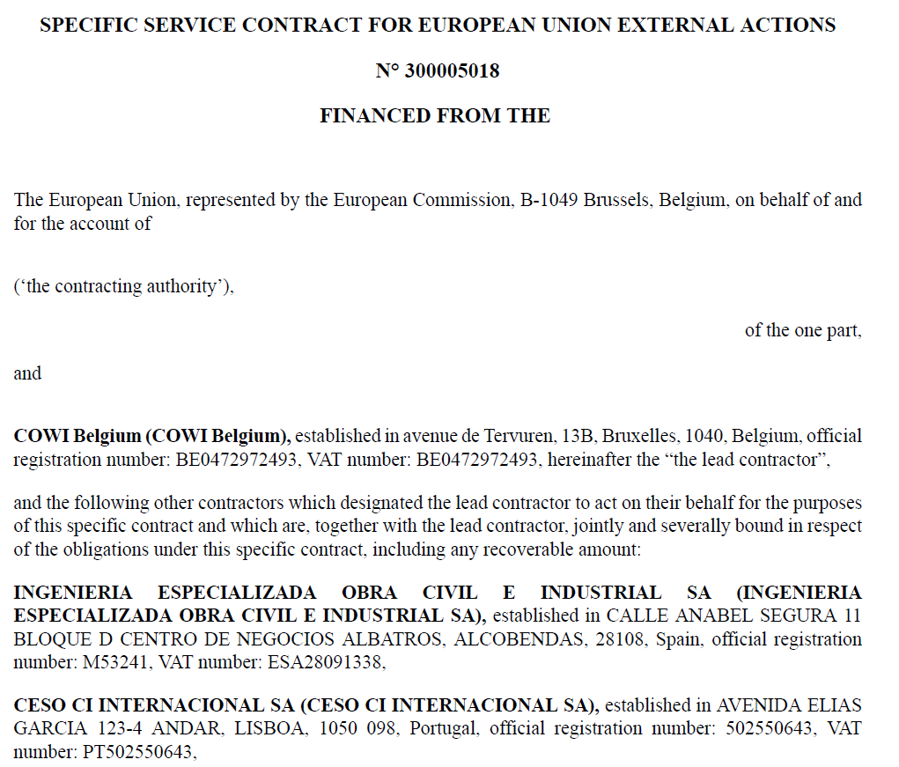
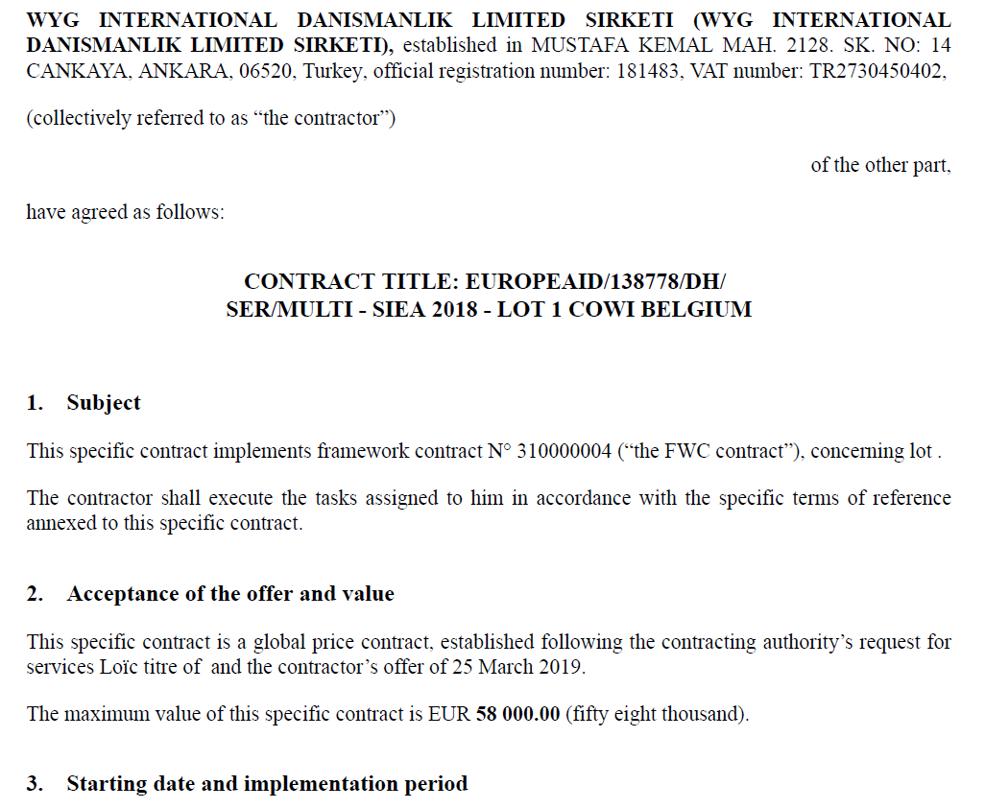
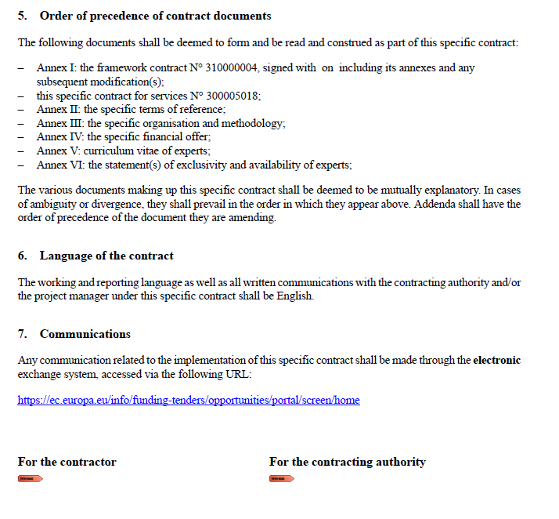
e-Signature of contracts

Slide 28
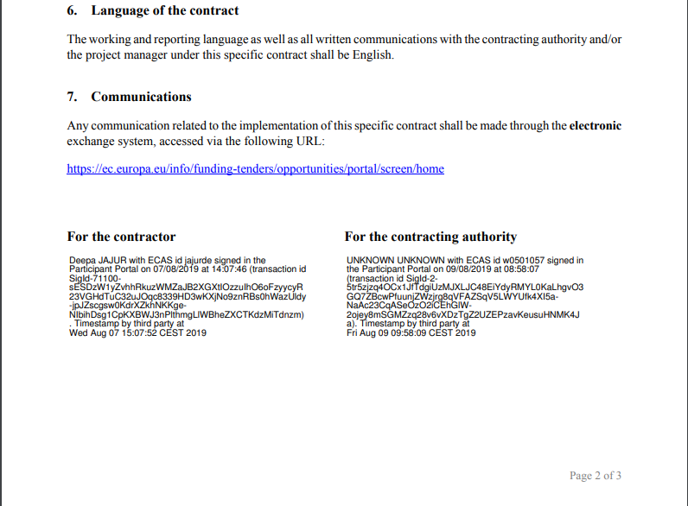
Sample of e-Signature

Slide 29
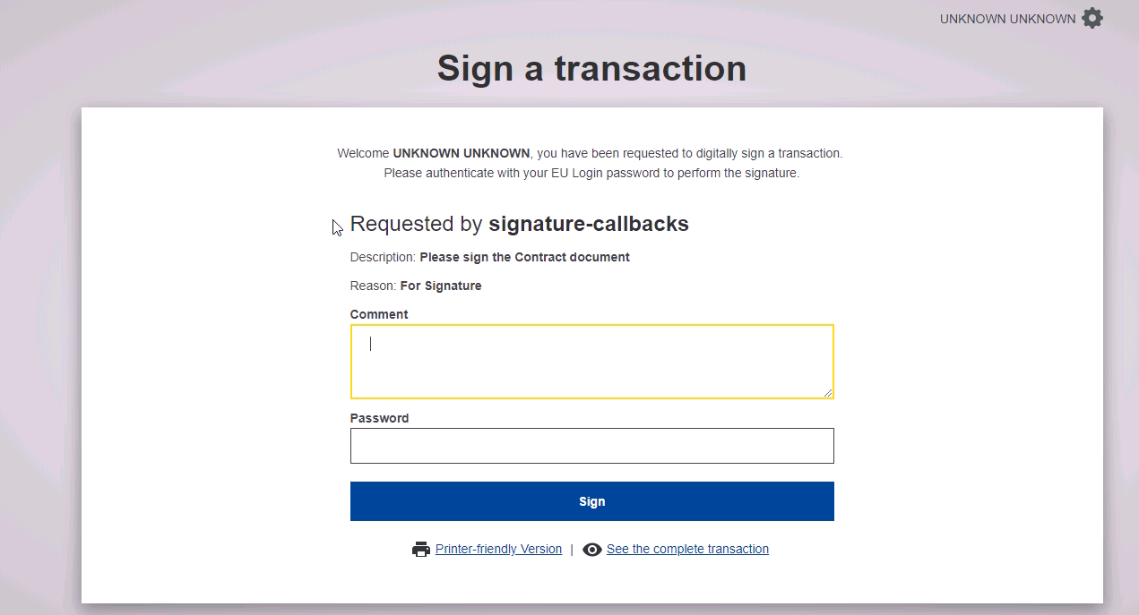
A Simple Process for e-Signature

Slide 30
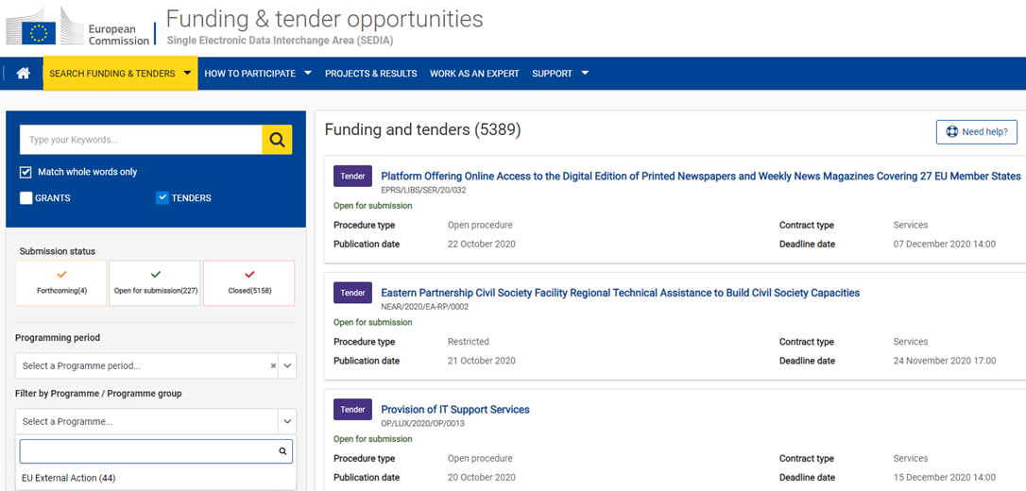
Locate a Call for Tender

Slide 31
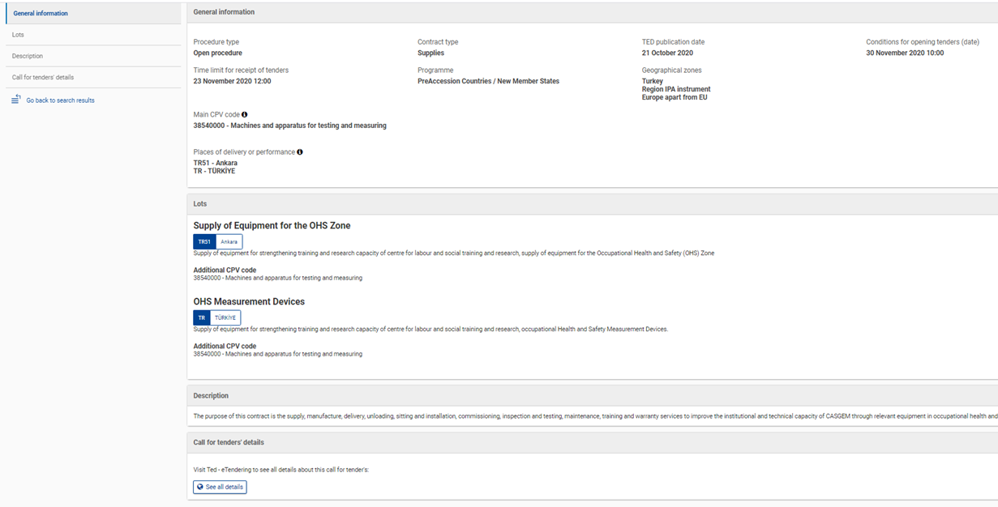
Link to eTendering - Access Contract Notice

Slide 32
Direct Award with e-signature
Contribution Agreement
Direct award of grants
Planned contract
No publication
Pre-award (on paper)
Contract preparation
Budgetary Commitment and Visa chain
E-signature
Management of Deliverables
Management of Amendments
Amendments initiated by Contracting Partner
Amendments initiated by EU
Closing of contract

Slide 33
Managing deliverables
Automated : The deliverables and their due dates (once the effective start date of contract is known) are automatically updated in the system. Deliverables are defined during the Request for Services preparation.
Report
Comments
MANAGE DELIVERABLES
Contracting Authority
OIA
OIA
CoCo
OIA
Encode deliverable at contract prep.
Record effective start date
Update contractual deliverables
Upload contractual deliverable
Approve contractual deliverable
Document
MANAGE DELIVERABLES
Contracting Partner
CoCo
Examples: Report, data set, document, assessment, study etc.
Upload ad-hoc deliverables

Slide 34
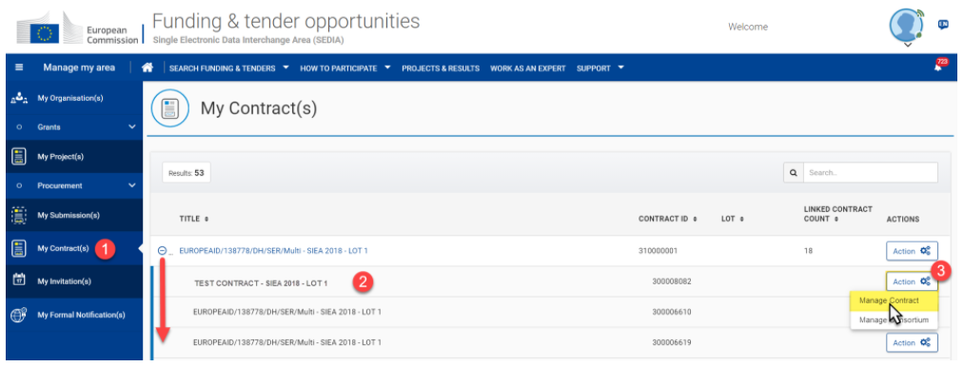
Managing deliverables in 'My Contracts'
In the Funding and Tenders Portal > My Contract(s) > Click on the “Action” button > select the “Manage Contract” option from the drop-down list
Know more

Slide 35
Amendments
Once a Specific Contract under a Framework Contract has been signed by both the Economic Operator (Contractor) and the Contraction Authority (European Commission), any modifications that would need to be applied to the Contract are done though Amendments.
The complete Amendment procedure workflow is managed in OPSYS Ecosystem, from the initiation, to the preparation, verification and signatures.
The types of modifications (Amendment Types) made to amend the signed contracts are for example: a change in the starting date, duration or budget allocation, a modification in the ToR(s), or a change in the pre-financing or annexes.

Slide 36
Amendments by EU with e-Signature
Annexes
AMENDMENTS initiated by EU
Contracting Authority
OIA/FIA
OVA
FVA
AO
OIA/FIA
OIA/FIA
AO
Prepare amendment
Generate automatic clauses
Select other clauses
Generate amendment
Visa chain and signature
Authorise in ABAC (if needed)
Draft Amendment
Amendment signed by EU
AMENDMENTS
Contracting Partner
LSIGN
Sign Amendment
Amendment signed

Slide 37
Amendments by Contracting Partner e-Signature
Annexes
AMENDMENTS initiated by Contracting Partner
CoCo
CoCo
LSIGN
Prepare amendment
Generate automatic clauses
Select other clauses
Generate amendment
Signature
OIA/FIA
Draft Amendment
Amendment signed by Contracting Partner
Consultation (if requested)
OIA/FIA
OVA/FVA
AO
AMENDMENTS
Contracting Authority
AO
Authorise in ABAC (if needed)
Visa chain and signature
Amendment signed

Slide 38
Release Update Highlights
Simplification in Tender Data Screen : Only one field 'Total Amount' instead of three. This amount can be with or without taxes/duties etc.
Submit Feature: Clear information message displayed in the Tender data screen to submit proposal if it is still a draft
Contact Person Feature: The User submitting the tender in eSubmission is by default the Primary Coordinator Contact (PCoCo) for the tender but s/he can choose to indicate someone else instead. If this person does not have an EU Login account, the system will automatically create a temporary one. After the tender is submitted, the PCoCo can withdraw the submission, view receipt, manage roles (after the opening session.)

Slide 39
The minimum configuration
In the Funding and Tender Opportunities Portal

Slide 40
Roles : Project and Organisation
Coordinating beneficiary
Participating beneficiary
Primary Coordinator Contact
PCoCo
LEAR
Legal Entity Appointed Representative
CoCo
Coordinator Contact
PCoCo
CoCo
TaMa
PaCo
TaMa
Project roles
TeMe
TeMe
PaCo
Participant Contact
Project roles
Organisation roles
PLSIGN
PFSIGN
PLSIGN
PFSIGN
AccAd
Account Administrator
TaMa
Task Manager
TeMe
Team Member
LSIGN
FSIGN
LSIGN
FSIGN
Organisation roles
LSIGN
Legal Signatory
PLSIGN
Legal Signatory assigned to a project
LEAR
AccAd
LEAR
AccAd
Financial Signatory assigned to a project
FSIGN
Financial Signatory
PFSIGN
Roles - Nomenclature

Slide 41
Default roles
PCoCo: The proposal initiator in the proposal submission phase will automatically be recognised by the Commission as the Primary Coordinator Contact.
PaCo: The "Main Contacts" of the participating organisations identified during proposal submission will become Participant Contacts at the beginning of the Grant/Contract preparation.
LEAR: The LEAR is validated by the Commission during the validation process of his/her organisation.

Slide 42
Access Rights
Project roles
PCoCo
CoCo
Read all forms
Write all forms
Submit forms to EC
Read own forms
Write own forms
Submit own forms
Sign and submit own financial forms
Read own forms
Write own forms
Submit own forms (except financial forms)
Sign own legal forms
PFSIGN
PLSIGN
Read own forms
Write own forms
Submit own forms to coordinator (except financial forms)
Organisation roles
PaCo
LEAR
View organisation data
Modify organisation data
View lists of organisation's projects, proposals and organisation roles
AccAd
TaMa
Read own forms
Write own forms
LSIGN
View organisation data
View lists of organisation's projects, proposals and organisation roles
Read own forms
TeMe
PLSIGN

Slide 43
Nomination/Revocation
PCoCo
CoCo
TaMa
TeMe
PLSIGN
PFSIGN
in own organisation, +
PaCo
Project level
CoCo
TaMa
TeMe
PLSIGN
PFSIGN
in own organisation, +
PaCo
CoCo
PaCo
PaCo
TaMa
TeMe
PLSIGN
PFSIGN
in own organisation
LEAR
AccAd
LSIGN
FSIGN
in own organisation
Organisation level
AccAd
LSIGN
FSIGN
in own organisation

Slide 44
The minimum configuration within a Consortium
The minimum configuration of an organisation/consortium is:
Organisation roles | Project roles
LEAR (per organisation) | Primary Coordinator Contact
Legal Signatory (per organisation) | Participant Contact (per beneficiary)
Financial Signatory (per organisation)
LEAR
PCoCo
LSIGN
PaCo
FSIGN

Slide 45
The nomination/revocation process
No Commission intervention in defining the roles, except for:
Organisation role | Project role
LEAR | Primary Coordinator Contact
LEAR
PCoCo

Slide 46
Summary
The minimum configuration of a consortium is:
The Primary Coordinator Contact
1 Participant Contact per beneficiary
1 LEAR per organisation
1 Legal Signatory per organisation
1 Financial Signatory per organisation
One person (= 1 EU Login account) can have as many roles as necessary at the same time (e.g. the owner of a one-person SME can be PCoCo, LEAR, PLSIGN and PFSIGN)
External Partners define the roles. There is no Commission intervention in defining the roles except for the LEAR and Primary Coordinator Contact.

Slide 47
Participant Identification Code
External Partner Registration Process in the
Funding and Tender Opportunities Portal

Slide 48
External Partner Registration
What is a PIC?
PIC stands for Participant Identification Code. This 9-digit reference is granted to an organisation that registers on the Funding & Tender Opportunties Portal. PICs will therefore replace PADOR’s EuropeAid IDs and complement Legal Entity Files (LEF)
A PIC will allow Applicants and Contractors in the Funding & Tender Opportunities Portal to:
Apply to future Calls for Proposals or Tenders;
Manage their ongoing Contracts;
Manage access roles for their organisation and receive notifications.

Slide 49
Purpose
A PIC Registration Campaign in the Funding & Tender Opportunities Portal was launched by INTPA PIC Management team in early 2020.
Addressed to Contractors impacted by the EC’s External Action
Why now?
To prepare for the migration from CRIS-Contracts Module to OPSYS Ecosystem-Contracts Module

Slide 50
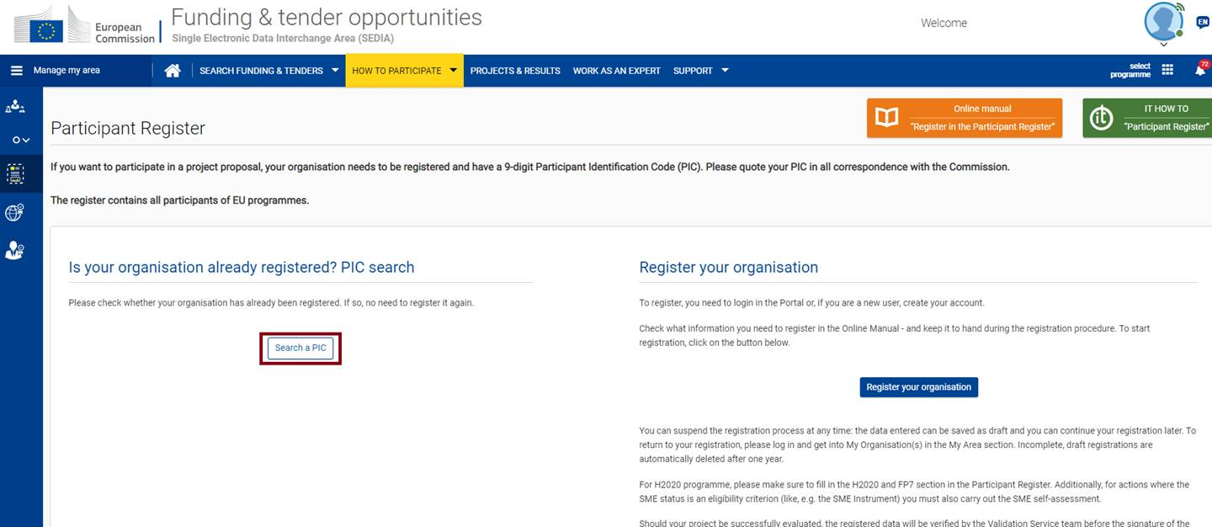
Search for your PIC
Menu > How to Participate > Participant Register > Search a Pic

Slide 51
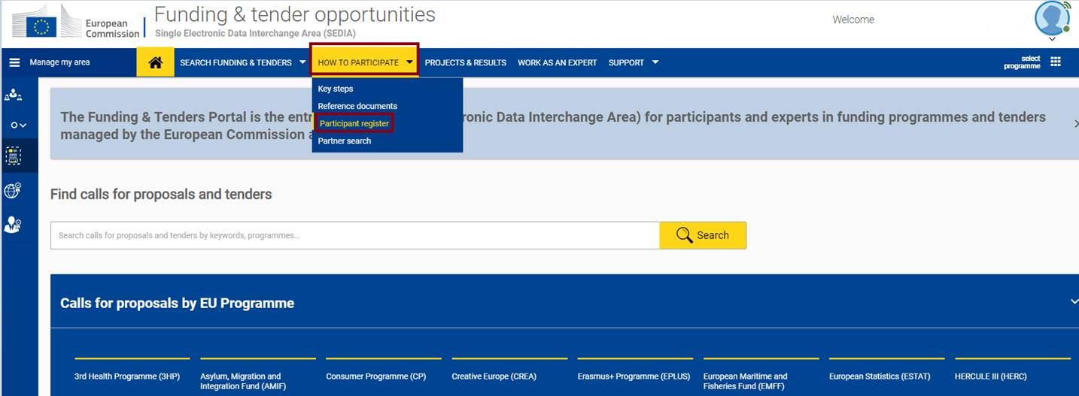
PIC Registration Process
In Menu, enter the tab 'How to participate' and click on 'Participant Register' to initiate the PIC registration process or verify if you have a PIC already
Menu > How to Participate > Participant Register

Slide 52
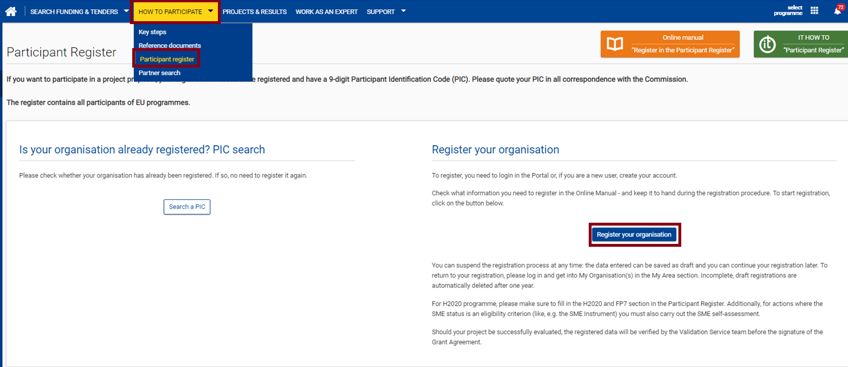
Register your Organisation
Menu > How to Participate > Participant Register > Register your organisation
Once your registration has been submitted you will receive a PIC number for your organisation and receive a confirmation email

Slide 53
External Partner Registration Process
The External partner obtains a PIC by registering directly in the Funding and Tenders Portal
The INTPA PIC Management team emails External Partner to:
To register in Funding and Tenders Portal and obtain a PIC
And assign the Primary Coordinator Contact (PCoCo) role to a person of your organisation.
PCoCo = key role within the organisation as manager of the project. The PCoCo, being the primary point of contact between the Commission and the participant for negotiations, is the person authorised in the Funding & Tenders Portal to grant access to other people from his/her organisation, manage roles, submit to European Commission and make changes to the documents.

Slide 54
External Partner Registration Process (2)
Contractor’s PCoCo registers the organisation’s profile in Funding and Tenders Portal and notifies the PIC to INTPA PIC Management functional mailbox
INTPA PIC Management collects PICs and sends them to Research Executive Agency (REA) for validation
REA validates PICs in line with the corrresponding Legal Entity File (LEF).

Slide 55
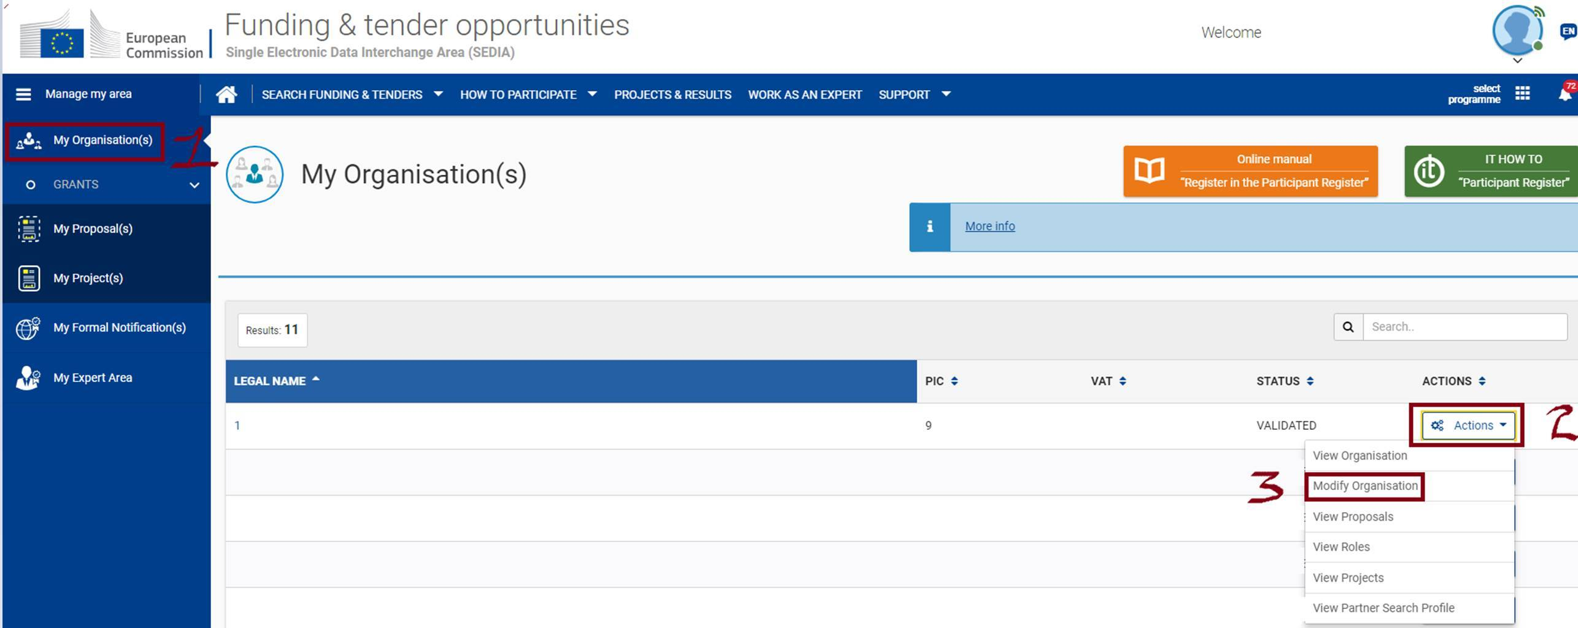
How to Contact the Validation Team?
Funding and Tenders Portal > My organisations > Action > Modify Organisation

Slide 56
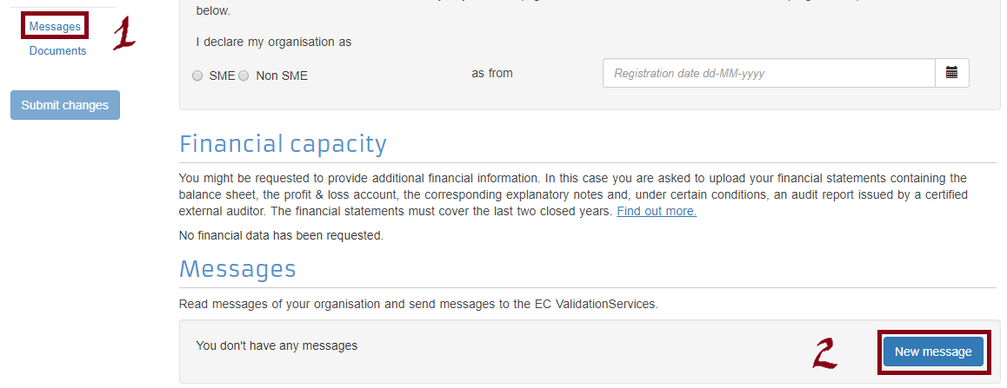
Contacting the Validation Team (2)

Slide 57
Changing the PCoCo
If an External Partner would like to modify the Primary Coordinator Contact :
1- You can make the changes in the Funding and Tender Opportunties Portal in 'My Submissions' after the Opening Session, in the tender submitted.
2- Address the request to the functional mailbox (FMB) of the respective Framework Contract, who will then forward the request (if validated) to the dedicated EC Funding and Tender Service Helpdesk service to apply the changes in the system:
SIEA 2018 - INTPA-FWC@ec.europa.eu | AUDIT 2018 - INTPA-R3@ec.europa.eu |
PSF 2019 - FPI-4-PSF@ec.europa.eu | EVA 2020 - INTPA-FWC-EVA@ec.europa.eu |
EVENTS 2020 - INTPA-FWC@ec.europa.eu
Know More

Slide 58
Change Management Resources
To support External Partners

Slide 59
OPSYS Ecosystem Throwback #2020
Contract Migration from CRIS begins
FWC Events 2020
EuropeAid phased out for Calls for Tenders
FWC EVA 2020
Release 3A: FWC SIEA 2018, AUDIT 2018, PSF 2019
Spring Release
PPMT
eProcurement
Summer
Release
Getting OPSYS ready for New MFF
Jan.
Feb.
Mar.
Apr.
May.
Jun.
Jul.
Aug.
Sep.
Oct.
Nov.
Dec.
To support users with these transitions
OPSYS Change Management and User Engagement Team worked relentlessly using a four-pronged approach

Slide 60
OPSYS Change Management Organisation
Documentation and IT Communication
IT Training to Users
Coaching and User Engagement
Outreach and Dissemination
￼

Slide 61
New Awareness Activities
Webinar for External Partners
8 April 2021 (EN)
28 April 2021 (FR)
6 May 2021 (ES)
New Video Tutorials in e-Learning, RELEX Internal Wiki
How to access and navigate the Funding and Tenders Portal
Watch the videos

Slide 62
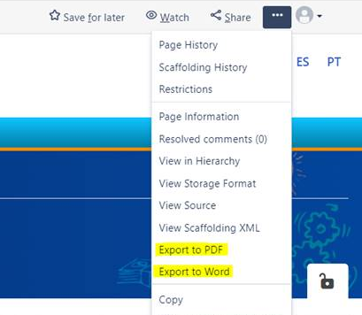
Accessing Documentation
You can read the information on the EXACT Wiki and download it, if required, by clicking on the three dots and exporting the information on the page to PDF or Word.
EXACT Wiki is now public! You do not need an EU Login to access it.

Slide 63
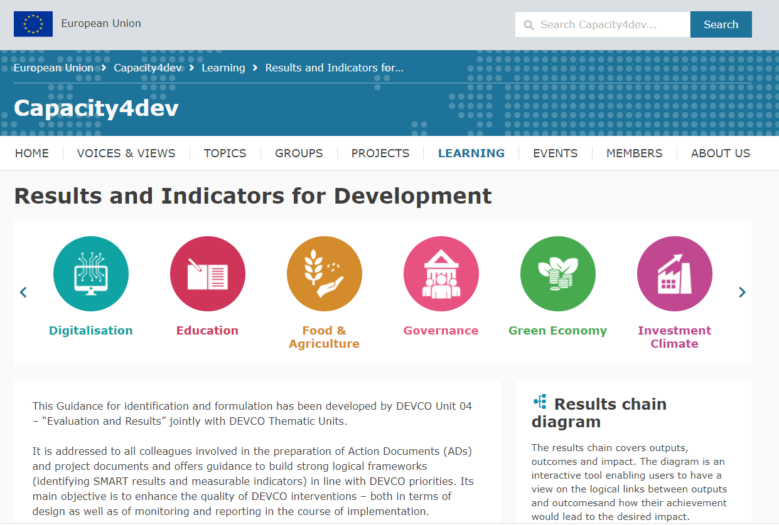
Accessing Core Indicators
You can access a proposed list of core indicators in line with INTPA priorities and OECD DAC terminology.
Capacity4Dev
List of Core Indicators
OPSYS Ecosystem Forum
Join the OPSYS Ecosystem Forum on Capacity4Dev for updates and resources

Slide 64
Useful links
About Procurement: https://webgate.ec.europa.eu/fpfis/wikis/display/ExactExternalWiki/Contracts+and+Procurements
External Actions Landing page in the Funding & Tender Opportunities Portal: https://ec.europa.eu/info/funding-tenders/opportunities/portal/screen/programmes/eu-external-actions
INTPA website Funding Page: https://ec.europa.eu/international-partnerships/funding/looking-for-funding_en

Slide 65
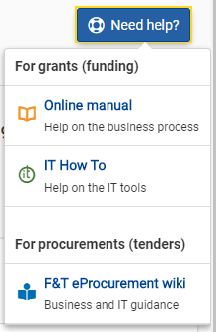
Requesting Support
Click on the link > Need Help? button
IT Support
Contact the Funding and Tender Service Desk:
EC-FUNDING-TENDER-SERVICE-DESK@EC.EUROPA.EU
Questions regarding PIC, nomination/revocation
Contact the PIC Management Team:
INTPA-PIC-MANAGEMENT@ec.europa.eu
Enrol for Webinars/Newsletter on OPSYS Ecosystem
Contact the Change Management and User Engagement Team:
EC-OPSYS-CHANGE-MANAGEMENT@ec.europa.eu

Slide 66
Contact
How to contact OPSYS Change Management and User Engagement?
To register for Awareness Webinars and the newsletter for External Partners
Send an email to EC-OPSYS-CHANGE-MANAGEMENT@ec.europa.eu
How to reach out for Technical Support?
External Users
New! Funding and Tender Service Desk: EC-FUNDING-TENDER-SERVICE-DESK@EC.EUROPA.EU

